Slide 1

Evaluation of Pediatric Fever
ANGELA COPE, DO, FAAP
Assistant Professor, UAB Dept of Pediatrics
Assistant Medical Director of UAB Pediatric
Primary Care Clinic
LMU –DCOM Alumni of 2015

Slide 2
Disclosures
I do not have any financial disclosures or conflicts of interest.

Slide 3

Learning Objectives
1
Define & Stratify
Define fever and stratify the febrile child by age and clinical appearance.
2
Apply the 2021 AAP Guideline
Apply the landmark AAP guideline to well-appearing febrile infants aged 8–60 days.
3
Interpret Inflammatory Markers
PCT, CRP, and ANC within validated risk-stratification tools (PECARN, Step-by-Step).
4
Determine Appropriate Testing
Determine appropriate use of UA, LP, imaging, and empiric antibiotics by clinical context.
5
Recognize Red Flags
Identify red flags mandating immediate escalation and escalate accordingly.

Slide 4

Defining Fever
Fever Definition:
Temperature ≥38.0°C (100.4°F).
Rectal measurement is most accurate in neonates and young children; oral is preferred in older cooperative children.
Key Terminology
FWS: Fever without source — <7 days, no source after H&P
FUO: Fever of unknown origin — >3 weeks duration
SBI / IBI: Serious/invasive bacterial infection (bacteremia, meningitis)

Slide 5
Clinical Impact
Fever is one of the most frequent chief complaints, encountered by several specialties, & can be a high stakes clinical scenario.
Despite the availability of updated, evidence-based algorithms, the clinical evaluation remains widely variable.

Slide 6

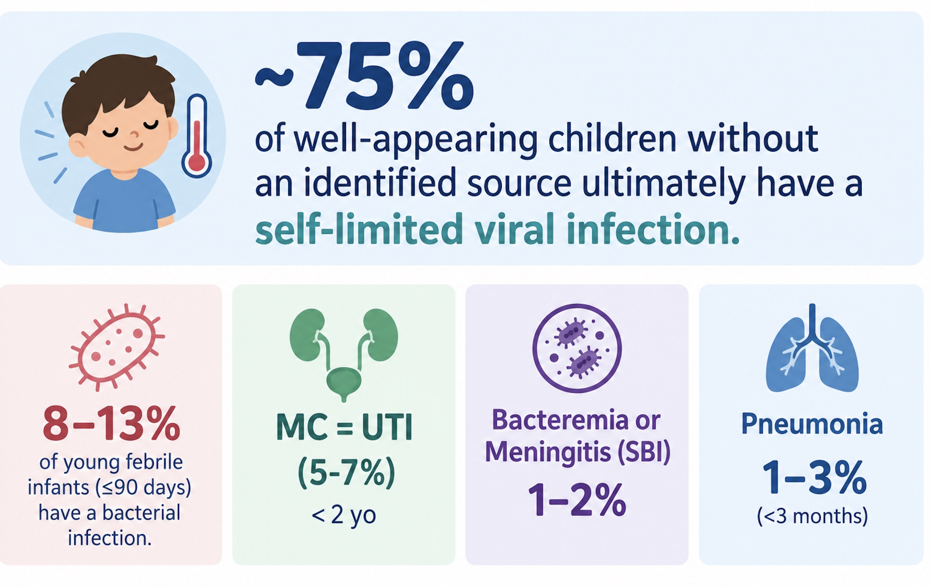
The Clinical Challenge
Key tension:
Identifying the small but critical subset with SBI/IBI while avoiding over testing, iatrogenic harm, and unnecessary antibiotic exposure

Slide 7
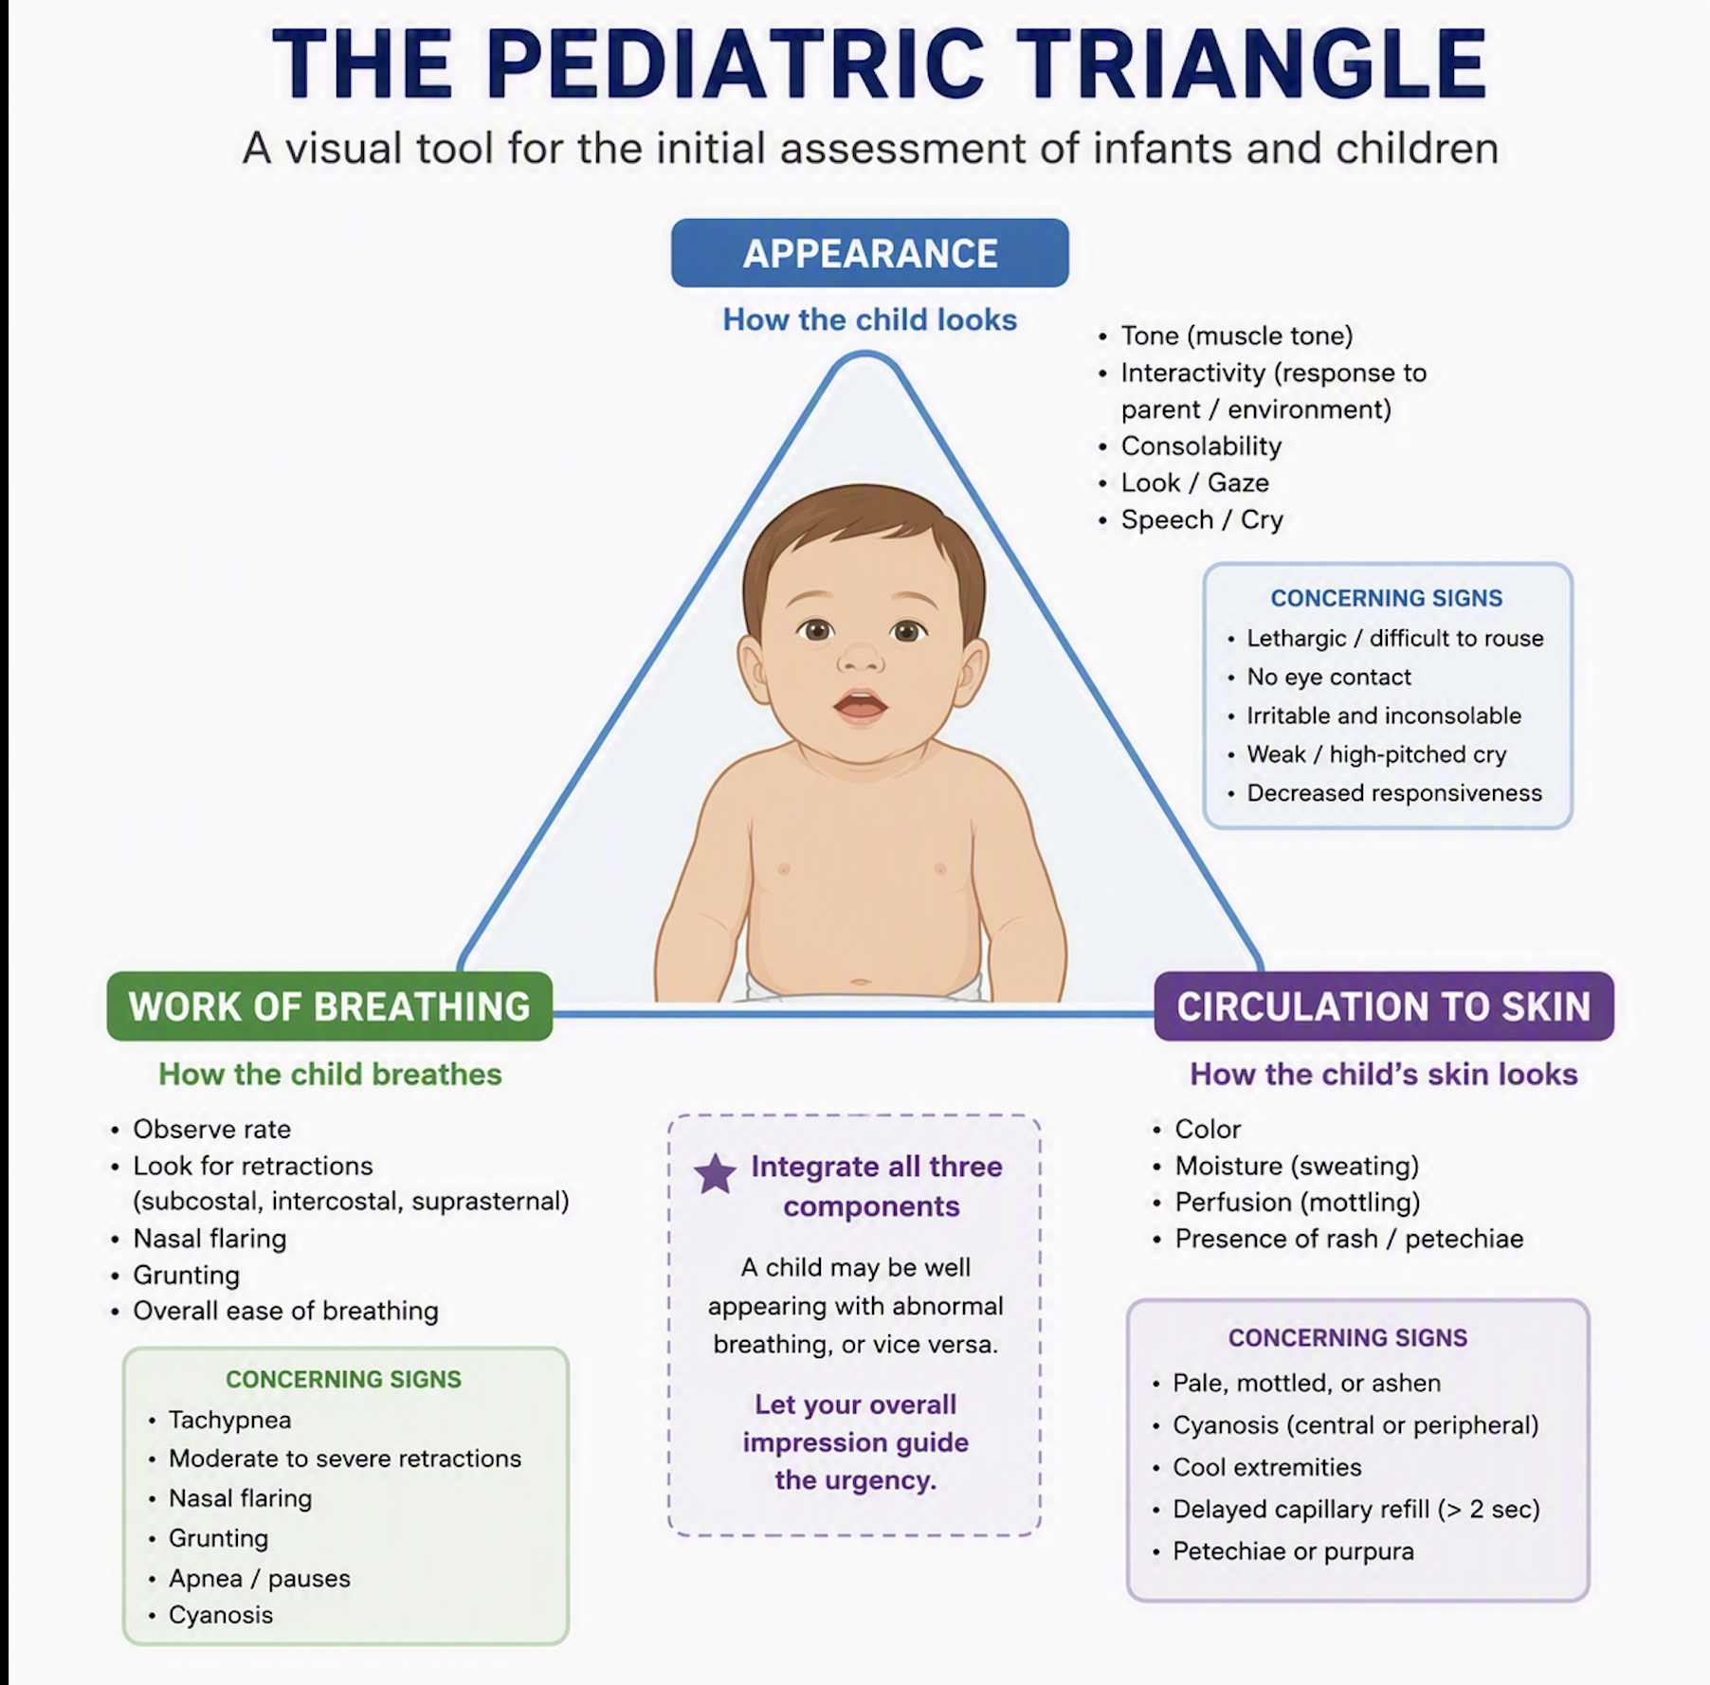
The Pediatric Assessment Triangle
The single most important screening step
Should precede all diagnostic testing.
  Exception being an infant < 1 month age
🚨 Red Flags Suggesting Serious Infection

Slide 8


Critical Teaching Point
Well-appearing does NOT exclude IBI in young infants. Many infants with invasive bacterial infection cannot be identified by examination alone
Important things to consider before risk-stratifying:
  Immunization history
  Sick contacts
  Birth history & Underlying Medical problems
  Vaccine era context
Occult bacteremia in the post-conjugate-vaccine era has fallen to ~0.5% in febrile children vs pre-vaccine was 3-15%

Slide 9
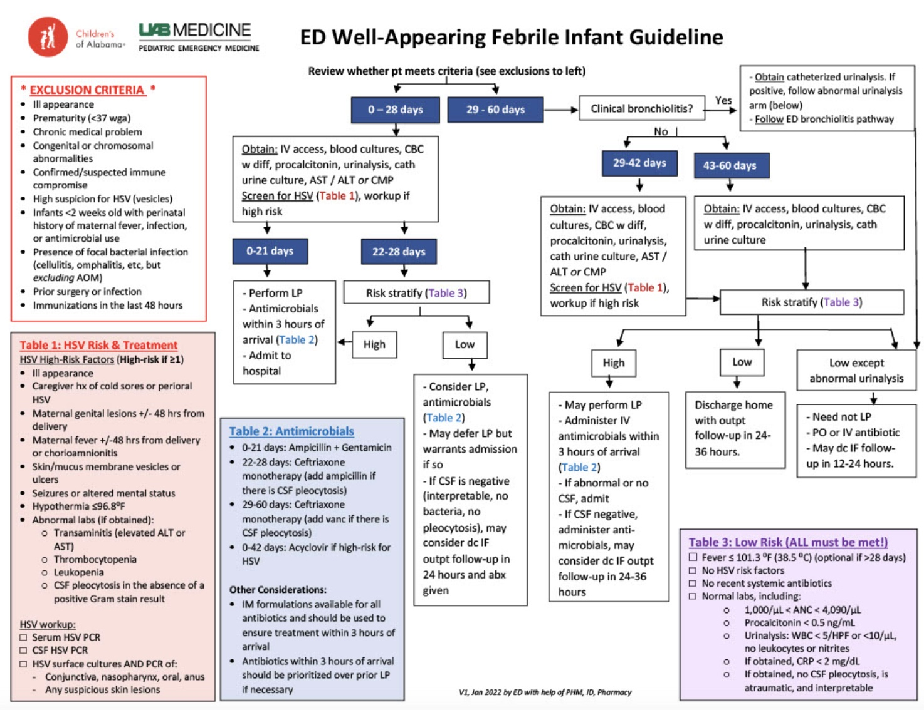
Fever Algorithm for infants: 0-60 days Old

Slide 10
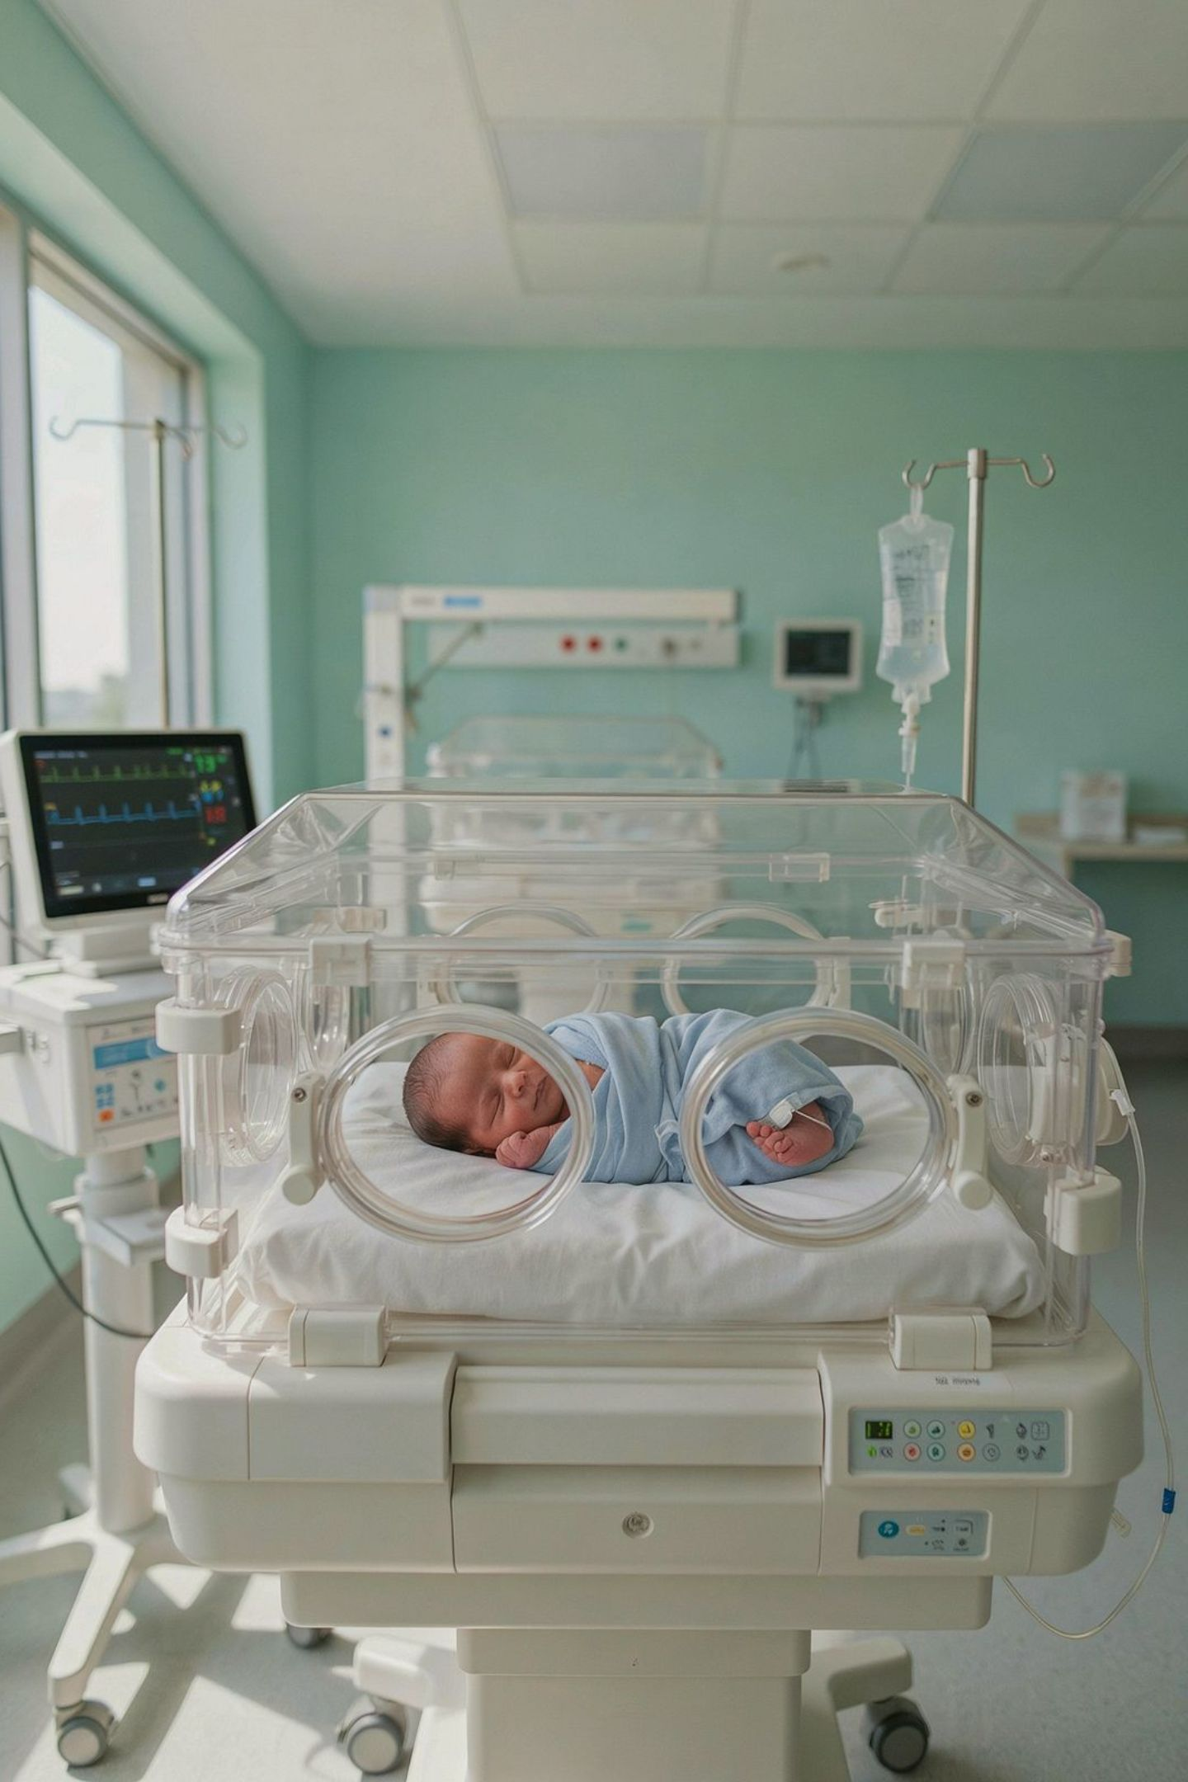
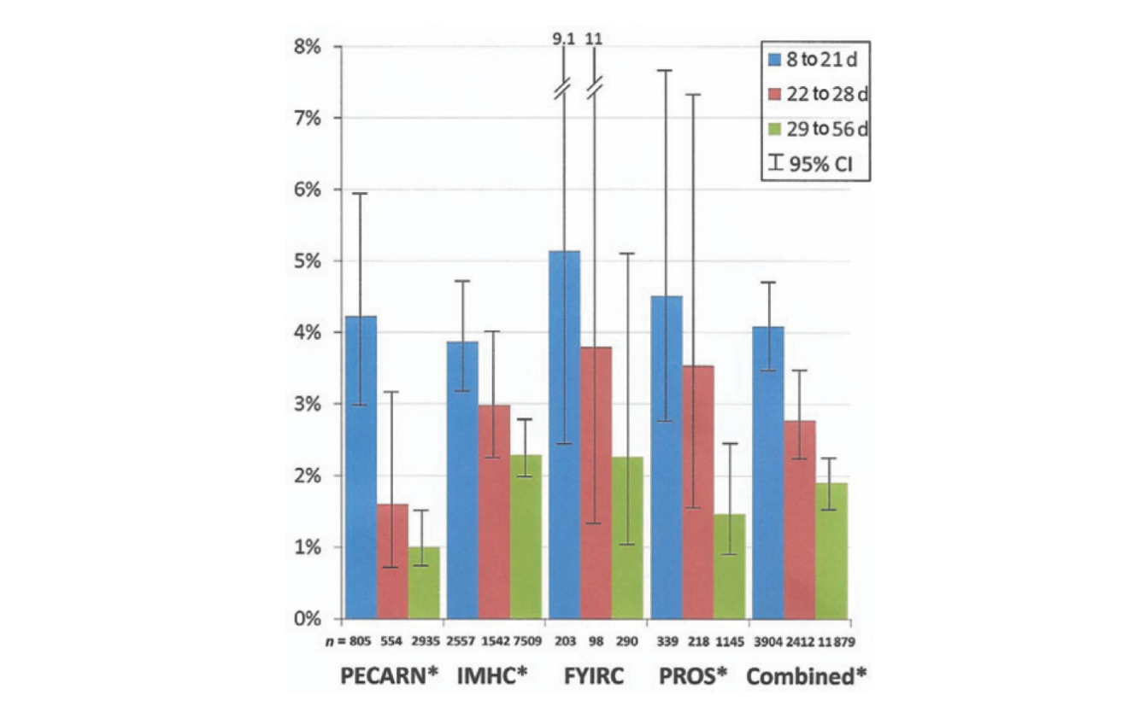
Neonates 0–28 Days: The Highest-Risk Group
Why Neonates Are Different
Approximately 4% of febrile neonates harbor invasive bacterial infection — and IBI cannot be reliably excluded on clinical exam alone
The immune system is immature, maternal antibody waning, and clinical signs are notoriously unreliable.

Slide 11
Standard Workup & Management
Full sepsis evaluation:
  CBC/diff
  blood culture
  urinalysis/urine culture
  LP/CSF analysis and culture
Empiric parenteral antibiotics:
  Ampicillin + gentamicin; consider cefotaxime if meningitis suspected
Add acyclovir if HSV risk factors
  (maternal hx, skin/eye/mouth lesions, seizures)
Hospitalization mandatory for all infants ≤21 days; strongly recommended through 28 days
No exceptions:
All febrile neonates ≤28 days warrant a full workup and empiric antibiotics regardless of appearance.

Slide 12

2021 AAP GUIDELINE
Infants 8–60 Days: The Practice-Changing Centerpiece
The most up to date comprehensive U.S. guidelines for evaluating pediatric fever
Structured into 3 aged based algorithms:
  8-21 days
  22- 28 days
  29-60 days
Why does it exclude ≤ 7 days old?
  It was on purpose
  Infants during the 1st week of life have incredibly different rates & types of infection.
  Infection is dominated by perinatal &peripartum acquired pathogens – GBS, E.coli, Listeria, & HSV vs community acquired pathogens seen > 7 day of life.

Slide 13
2021 AAP GUIDELINE: Important Considerations
Only applies to previously healthy full term infants, ≥37 weeks + well appearing
Exclusion criteria:
  Born ≥42 weeks
  Immunocompromised
  Congenital/chromosomal anomaly
  Focal bacterial infection
  Medical fragility
  Recent immunization

Slide 14
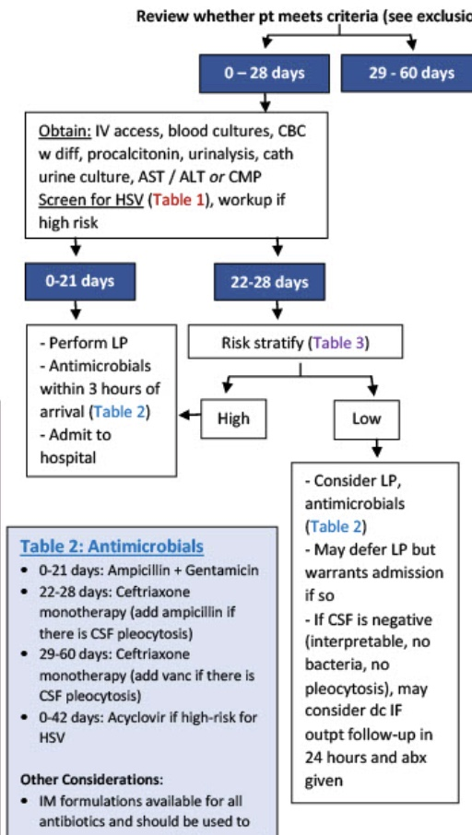
0-21 days

Slide 15
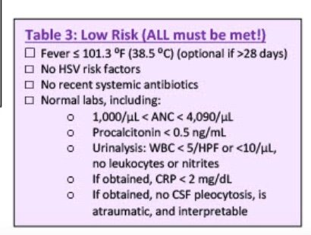
22- 28 days

Slide 16
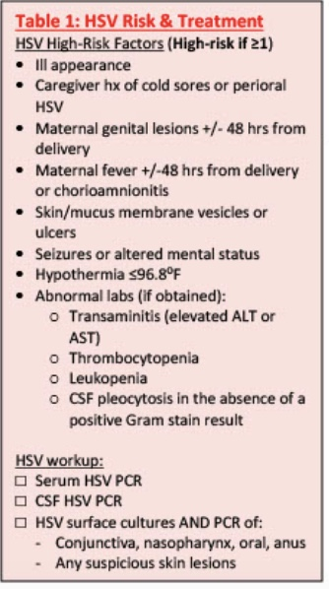
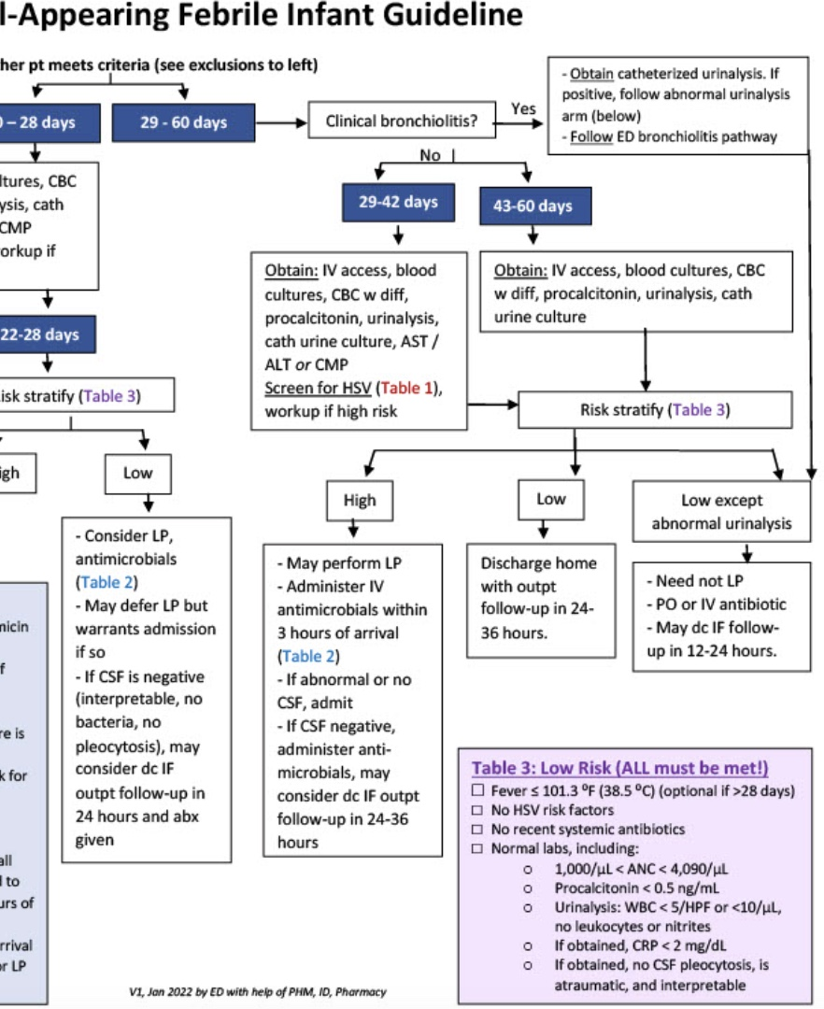
29-60 days
Shared Decision-Making: Engage caregivers transparently around LP indication, admission vs. outpatient monitoring, and return precautions. Document the conversation.

Slide 17
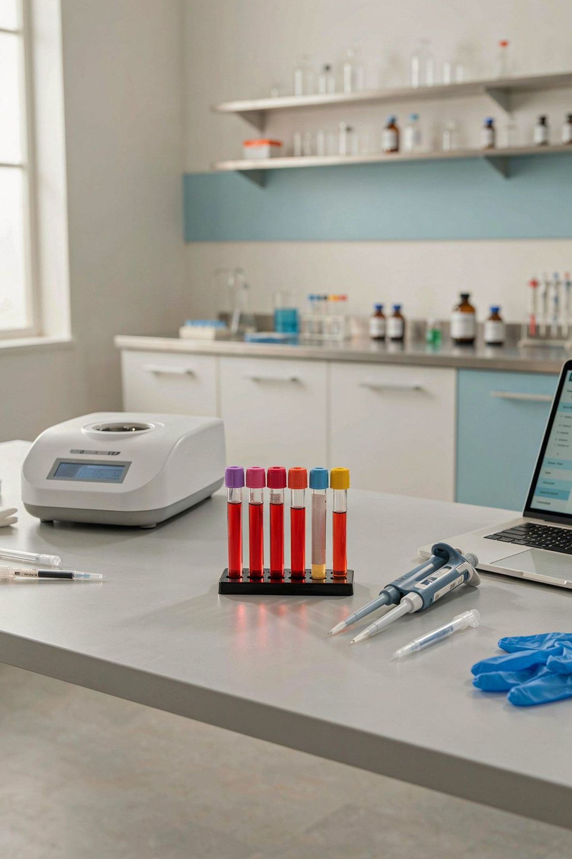
Diagnostic Tools: Inflammatory Markers
Inflammatory Markers — Ranked by Utility
1
2
3
Procalcitonin (PCT)
CRP
WBC / ANC
Comparable to PCT for SBI but inferior for IBI; useful surrogate when PCT unavailable. CRP <2 mg/dL serves as a low-risk threshold (Borensztajn et al., BMC Pediatrics, 2025).
Poor sensitivity for IBI in isolation. Less useful in the post-E. coli era (Pantell et al., AAP, 2021). ANC ≤4,000 is incorporated into PECARN as a low-risk criterion alongside PCT.
Best single marker for IBI. Rises earlier than CRP. ≤0.5 ng/mL = low risk for invasive disease (Marom et al., AAP, 2025; Milcent et al., JAMA Peds, 2016). Cornerstone of PECARN rule.

Slide 18
Take-Home Points
1. Age + Appearance Drive Everything
2. PCT Is the Modern Backbone
3. Admission Is Not Always Required
Procalcitonin ≤0.5 ng/mL combined with ANC and UA forms the PECARN low-risk profile
Use validated tools — not reflexive labs — to guide decisions
Drives both workup intensity and disposition planning
Stratify first by age band, then refine with the Pediatric Assessment Triangle
Neonates always get a full workup — no exceptions
Well-appearing older infants can be risk-stratified for outpatient management
Well-appearing infants 29–60 days meeting low-risk criteria may be managed at home
Per 2021 AAP guidelines — outpatient follow-up with return precautions
Neonates always warrant full evaluation and hospitalization

Slide 19

Children 3–36 Months: Targeted Evaluation
UTI is the most common SBI in this age group (predominant organism: E. coli).
Urinalysis and urine culture are indicated for any unexplained fever (Cooper et al., ACR, 2025; ACEP, 2016).

Slide 20
Children 3–36 Months: Targeted Evaluation​
Chest radiography:
  Rarely needed >28 days without respiratory localizing signs; reserve for tachypnea, hypoxia, or high suspicion for occult pneumonia
LP:
  Not routine in children >3 months without meningismus or localizing signs
Rapid viral testing:
  Influenza, COVID-19, RSV when seasonally circulating — a positive result changes management significantly
Low-risk, well-appearing:
  Close outpatient monitoring with clear return precautions is safe and appropriate

Slide 21
Older Children & Special Scenarios
Localize the source through history and physical exam first.
Imaging and laboratory evaluation should be symptom-directed rather than reflexive.
Consider FUO Workup When:
Fever persists >3 weeks without explanation;
Recurrent unexplained febrile episodes
Consider Kawasaki Disease — Fever ≥5 days with ≥4 classic features — or incomplete Kawasaki in infants. Do not miss this diagnosis; coronary artery aneurysm is preventable with timely IVIG.

Slide 22
Definition:
Fever of Unknown Origin (FUO): ​
  ≥ 8 days, daily documented fevers (≥100.4) with no source from history or exam findings​
Fever without source (FWS): < 8 days​

Slide 23
Fever of Unknown Origin ​
Diagnosis is found: ~50% of the time​
#1 cause infectious etiology ​
Followed by: ​
    Autoimmune Disorders​
    Malignancies ​
    Miscellaneous: i.e- Kawasaki Disease, MISC, serum sickness, drug fever, thyrotoxicosis, period fever ​
    Factious fever/ Munchausen by proxy​

Slide 24
Words to the Wise
Common Pitfalls before establishing a diagnosis:
    Antibiotics
        Antibiotics can affect culture results and obscure clinical picture
    Oral steroids
        Steroids can suppress fever and effect labs
        Can cause leukocytosis (don’t want to mask leukemia or neutropenia)
        Normalize CRP/ ESR and thus confusing your clinic picture; autoimmune disorder or Kawasaki's disease

Slide 25

History: FUO
Most common reason why a diagnosis is missed
    We did not ask the right questions
    We missed key historical clues

Slide 26
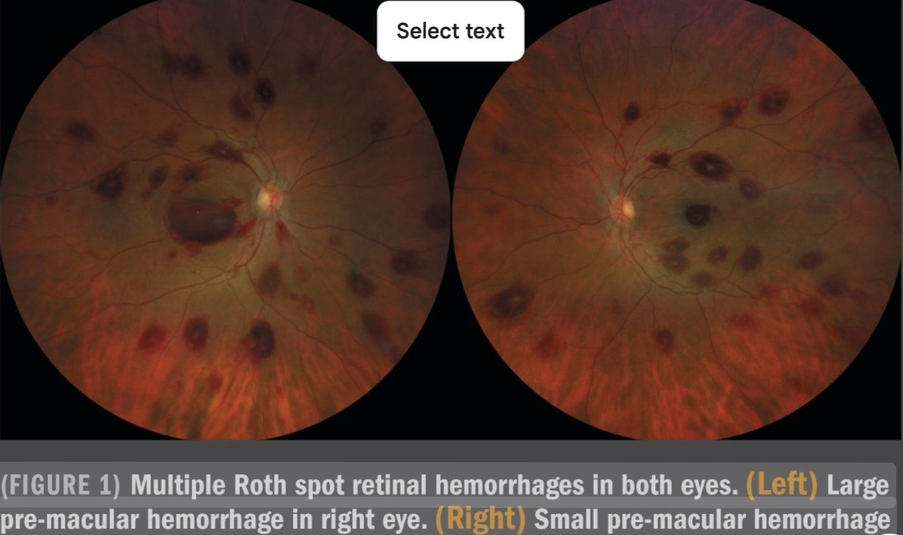
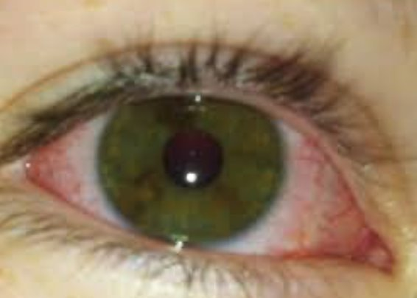
Physical Exam: FUO
Roth's Spots
Head-toe
    Needs to be a comprehensive exam:
        Be complete and through!!!
What are some exam findings?
    Eyes:
        Roth's Spots: endocarditis, leukemia, connective tissue disorders
        KW's: Conjunctival injection
Bilateral non-exudative
limbus sparing

Slide 27
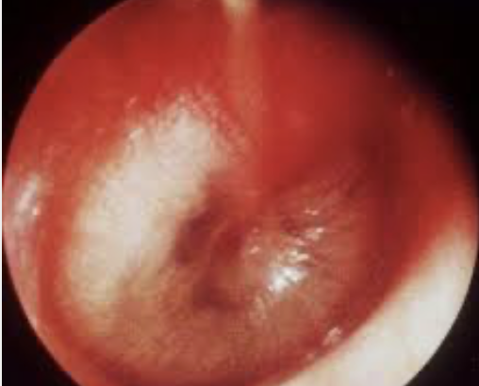
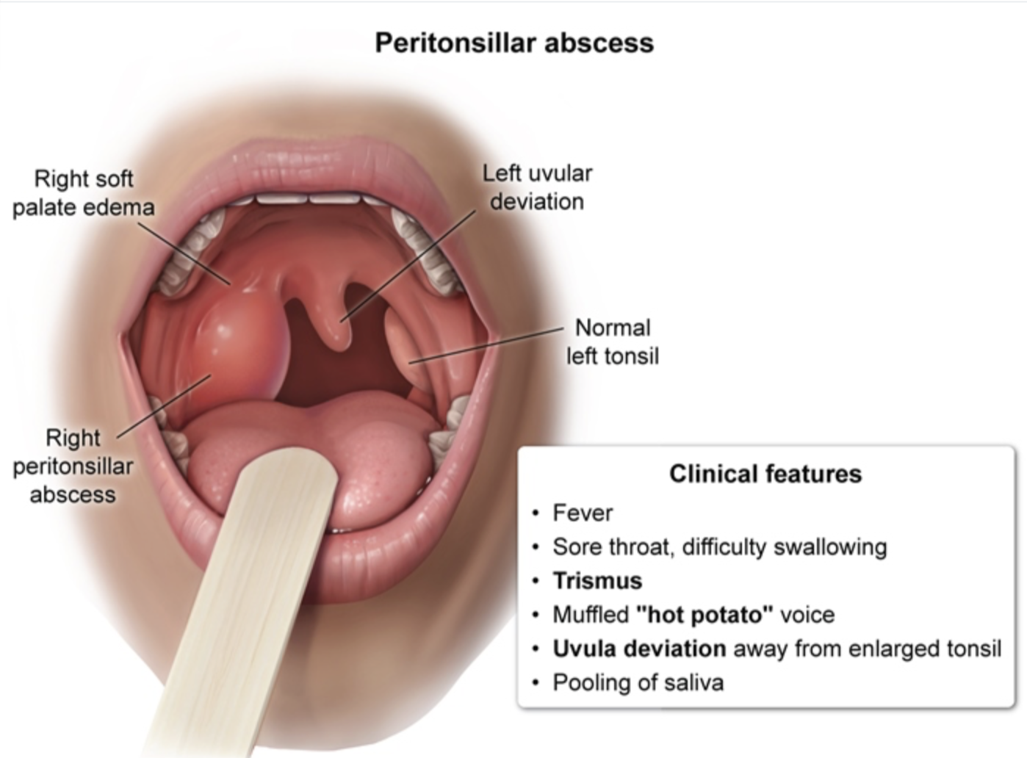
Exam Findings
Ears & Nose:
OM, OE, mastoiditis
nasal abscesses
Mouth and throat:
Teeth & gums, mouth ulcers
Exudates, petechiae, tonsillar & retropharyngeal abscesses

Slide 28
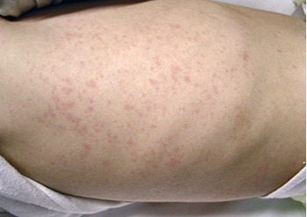
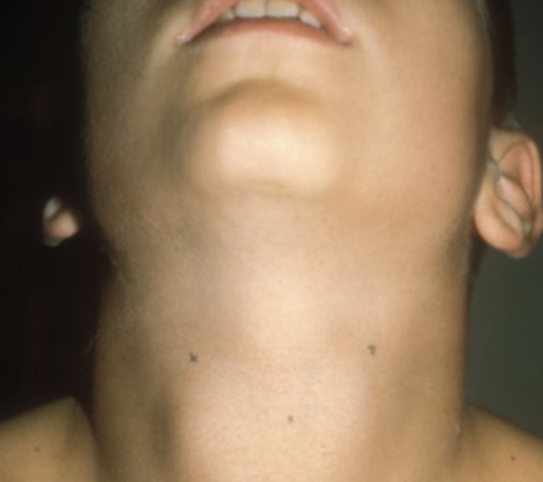
Exam Findings
JIA-> salmon-pink" rash
Neck:
Lymphadenopathy, thyromegaly (thyrotoxicosis)
Cardiac:
new heart murmurs (endocarditis or atrial myxoma)
pericardial friction rub (pericarditis)
MSK:
swollen joints-> JIA, inability to bear weight, swollen joint -> osteomyelitis/ septic arthritis
Skin:
Rashes
Notes:
JIA- "heat rash" usually presents with fever spikes and is mostly under the axillae and around the waist, but can be anywhere

Slide 29
Work up: FUO
Outpatient work up: well appearing patient with no red flags
    CBC with diff and smear
    CMP
    ESR,CRP
    BC
    UA & urine cx
    +/- CXR
    Note: Your history and exam findings will guide you for more specific labs, i.e bartonella titers with cat exposure, EBV & CMV with sore throat and hepatosplenomegaly.

Slide 30

FUO: Admission
Ill- appearing
Immunocompromised or infant ≤ 28 days
Vitals signs suggesting SEPSIS!
Abnormal neuro exam or signs of meningitis
Significant lab abnormalities
Neutropenia
More than 1 cell line is significantly down (WBC/HGB/PLT)
Inflammatory markers are significantly elevated

Slide 31
Real Life Case:
2 siblings, 11 yo male and 9 yo female, h/o of non-verbal ASD, but otherwise healthy, who present to clinic with fever X5 days with associated chills, malaise, and decreased PO intake. They see another provider and receive covid, flu, and rsv testing which is negative.
They return to clinic later that week and now have been having fever for 9 days and no new symptoms. Further questioning reveals from Father they have been "very sick" and not able to go to school. No associated URI symptoms or cough. Upon further questioning, family and pts returned from Nigeria 2 weeks ago.

Slide 32
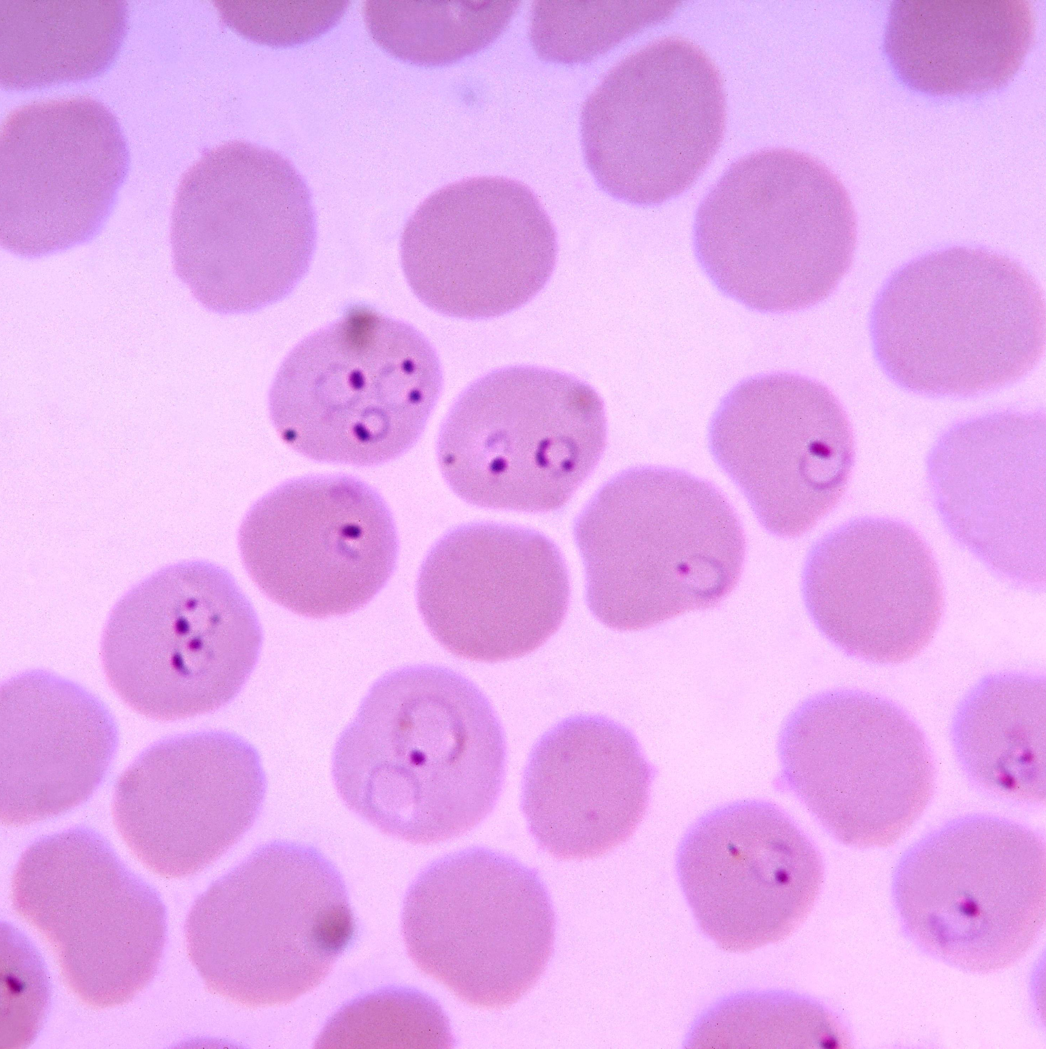
Malaria
Symptom onset occurs ~10-15 days after mosquito bite
Transmitted by the Plasmodium species
Typically seen on blood smear

Slide 33
Case Resolution
History is so important!!!
Patients returned from an endemic area with Malaria and developed symptoms in the right time frame
ID at a children's hospital was consulted
They met patient in the ED and diagnosis was confirmed to be Malaria with peripheral blood smear!
After spending a few days in special care, they recovered!

Slide 34

🚨 Red Flags: Escalate Immediately
Ill or toxic appearance at any age
Petechiae or purpura — meningococcemia
Hemodynamic compromise — tachycardia, poor perfusion, hypotension
Age ≤ 21 days — always full workup
Febrile neutropenia — ANC <500
Meningismus or signs of CNS infection
Kawasaki disease features — fever ≥5 days
When in doubt — err toward escalation. The cost of under-treating IBI exceeds the cost of a workup.

Slide 35


