Slide 1
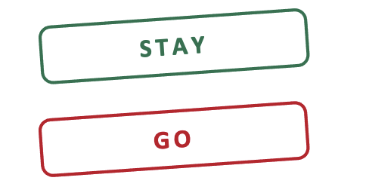
Chest Pain Emergencies in the Primary Care Office: Who Can Stay, Who Must Go?
Mark Gustafson, DO FACEP
LMU-DCOM Class of 2012
Professor & Vice Chair of Education, Dept. of Emergency Medicine
Associate Designated Institutional Official, CAMC Institute for Academic Medicine

Slide 2
Financial Disclosures
Presenters/Planners or others involved in the development of this program DO NOT have an interest in selling a technology, program, product, and/or service to CME/CE professionals.
None of the Planners or Speakers for this presentation have relevant financial relationships to disclose.
The content of this presentation does not relate to any product of a commercial interest. Therefore, there are no relevant financial relationships to disclose.

Slide 3
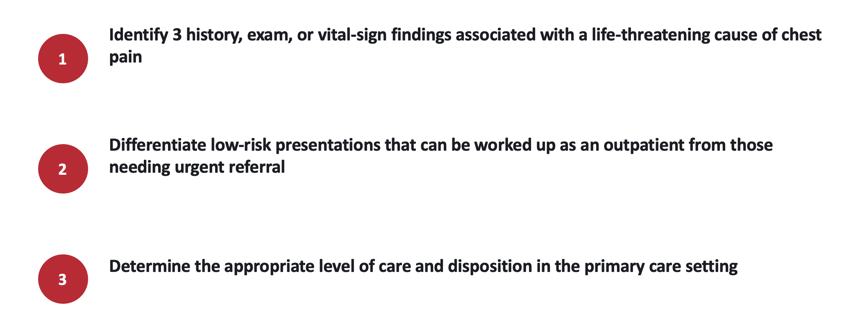
Objectives

Slide 4
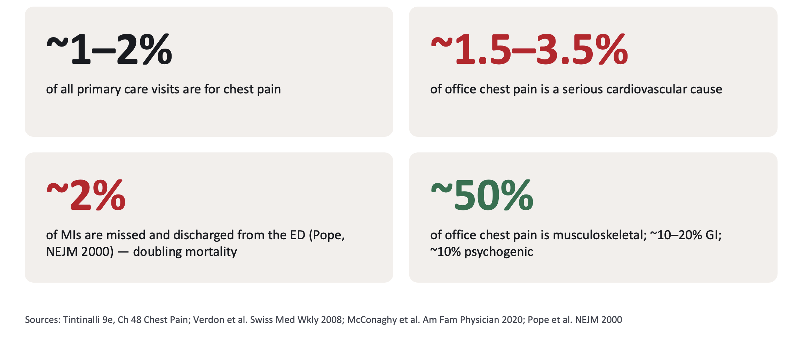
Chest Pain by the Numbers

Slide 5
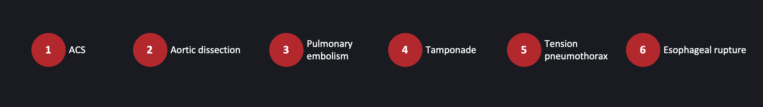
The Deadly Six
Six diagnoses that can kill within hours

Slide 6

Objective 1: Three findings that end the visit
VITAL SIGNS
HISTORY
EXAM
Any one abnormal vital sign
Onset & character
The 30-second physical
SBP < 90 or HR > 100
SpO₂ < 90%
Arm-to-arm SBP difference > 20 mmHg
Pulsus paradoxus > 12 mmHg
Abrupt, maximal-at-onset pain
Pain radiating to both arms
Syncope or near-syncope with chest pain
Exertional Component
Pain after forceful vomiting or endoscopy
New murmur or S3
Unilateral absent breath sounds
JVD
Diaphoresis
Dyspnea with clear lungs
Unilateral leg swelling Subcutaneous emphysema
Pulse deficit
Focal Neuro Deficit
Notes:
[4:30–6:30] This is Objective 1 in one slide, and it's the slide I'd screenshot. Three buckets: vitals, history, exam. If any bullet here is present, the disposition conversation is over — they're going.
Vital signs: the cheapest test you own and the one most often skipped. Two arm pressures take 90 seconds. Pulsus paradoxus takes a manual cuff and patience. Teach the MA to flag any HR > 100 in a chest-pain patient before you walk in.
History: "abrupt" is the single most underweighted word in chest pain. Patients with ACS usually describe a crescendo over minutes; patients with dissection, PTX, PE and rupture describe a switch being flipped. Ask "did it start in a second, or build up?"
Exam: you're not looking for subtle things. You're looking for a murmur that wasn't there last year, one side of the chest that's quiet, a neck vein you can see from the door.

Slide 7
Acute coronary syndrome
1
10–15%
Likelihood ratios
Office pearls
of ED chest pain is ACS;
In the office: ~1.5–3%.
Finding | LR+
Radiation to both arms | 7.1
Radiation to R arm/shoulder | 4.7
Third heart sound | 3.2
Hypotension | 3.1
Radiation to L arm | 2.3
Diaphoresis | 2.0
Exertional | 2.4
Relief w/ Nitro or Gi Cocktail | 1
Pleuritic / positional | 0.2 / 0.3
Reproducible by palpation | 0.2–0.4
ECG - 10 min of arrival
Normal ECG does NOT rule out: 1–6% of MIs have a normal initial ECG
No troponin = no HEART score.
ASA 324 mg chewed if ACS likely
New or changing pattern = unstable angina -> ED, even if pain-free now
History & exam clues
Pressure/tightness, exertional, crescendo over minutes
Radiation to arms, jaw, neck; diaphoresis, nausea
Beware: 1/3 of MIs have no chest pain: women, elderly, diabetics → dyspnea, fatigue, 'indigestion'
Notes:
[6:30–8:30] ACS is the common killer, so the base rate is the highest of the six. Three teaching points:
1. The LR table (Swap & Nagurney, JAMA 2005; Tintinalli 9e). Radiation to BOTH arms is the single strongest historical feature — LR+ 7. Diaphoresis and exertional pain help modestly. The negatives matter too: pleuritic, positional, and palpation-reproducible pain each have LR ~0.2–0.3 — helpful, but 0.3 × a 5% pretest is still 1.5%, so none of them is a rule-out on its own (Body et al. showed reproducible pain was present in ~ 1 in 6 confirmed MIs).
2. Response to nitro/GI cocktail: LR ≈ 1. Please stop using it as a test. Esophageal spasm responds to nitro; MI responds to Maalox by coincidence.
3. The office has no troponin. The HEART score was derived and validated with a troponin — without the T you cannot call anyone low risk by HEART. What you CAN do: ECG in 10 minutes, compare to old, and ask whether this is new/changing (unstable) or months-old and predictable (stable).
Aspirin caveat: if the story is abrupt/tearing/back/pulse deficit, hold the aspirin until the aorta is imaged.

Slide 8
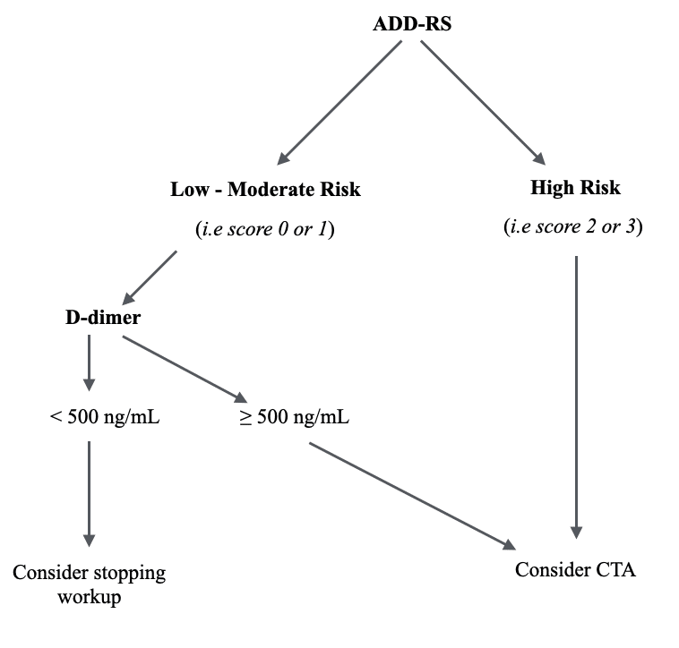
Aortic dissection
2
~3 / 1,000
Likelihood ratios
Office pearls
ED chest-pain patients (~0.3%).
Finding | LR+
Tearing / ripping quality | 1.2–10.8
Focal neuro deficit | 6.6–33
Pulse deficit / BP differential | 5.7
Migrating pain | 1.1–7.6
Gradual Onset | 0.3
Normal Mediastinum on CXR | 0.3
Two-arm BP on every chest pain. >20 mmHg difference = red flag
ADD-RS: Score ≥2 → CTA now
ADD-RS ≤1 + D-dimer <500 → dissection effectively excluded (ADvISED trial)
Listen for a new diastolic murmur (AR): ~30% of type A
HOLD aspirin/anticoagulants; call 911; target HR <60, SBP 100–120 in the ED
History & exam clues
Abrupt, severe, maximal at onset- 'tearing/ripping’
Pain that migrates (chest → back → abdomen)
Hypertension in 50–70%; but ~20% of type A are hypotensive
Marfan/EDS, bicuspid valve, prior cardiac surgery, cocaine, pregnancy
Chest pain + neuro deficit or a cold/weak limb = dissection until proven otherwise
Notes:
[8:30–10:30] Dissection is rare — 3 per 1,000 ED chest pain — but it's the diagnosis most often sued, because it masquerades as ACS and the usual ACS treatment (aspirin, heparin, cath) is catastrophic.
LRs from Klompas, JAMA 2002 Rational Clinical Examination: "tearing/ripping" is specific but the confidence interval is wide and only ~half of patients use the word. Abrupt onset is the sensitive one — if the pain built up gradually, LR− 0.3. Pulse deficit or arm-to-arm BP difference LR+ 5.7 — that's your two-arm BP. Focal neuro deficit LR+ 6–33.
ADD-RS (aortic dissection detection risk score) from the 2010 AHA guideline: three columns — high-risk conditions (Marfan, family history, known aneurysm, prior aortic manipulation), high-risk pain (abrupt, severe, tearing), high-risk exam (pulse deficit, BP differential, new AR murmur, hypotension, neuro deficit). One point per column. ADvISED (Nazerian, Circulation 2018): ADD-RS 0–1 plus D-dimer <500 missed ~0.3% — that's the only validated rule-out pathway, and it needs a D-dimer, which means they're probably leaving your office anyway.
Office pearl: the patient with "ACS" and a normal ECG whose pain started in one second and went to the back — image the aorta before you give aspirin.

Slide 9
Pulmonary embolism
3
~1–2%
Likelihood ratios
Office pearls
of ED chest-pain patients.
Finding | LR+
Clinician gestalt 'high' | 5.7
Unilateral leg swelling | 2.6
Syncope | 2.4
Hemoptysis | 2.6
HR > 100 | 1.5–2
SpO₂ < 95% | ~2
Pleuritic pain | ~1.5
Step 1: gestalt
Step 2: Wells: moderate → D-dimer. Wells high → ED for CTPA
Step 3: Low Wells-> PERC- If All negative → stop.
PERC fails on: age ≥50, HR ≥100, SpO₂ <95%, estrogen, prior VTE, surgery/trauma 4 wk, hemoptysis, leg swelling
A D-dimer you can't get back today is a reason to send, not a reason to wait
History & exam clues
Pleuritic pain + dyspnea + tachycardia is classic
Classic Sx absent in 1/3
Unexplained dyspnea or tachycardia is the MC 'atypical' presentation
Syncope + chest pain
Risk: surgery/immobility, estrogen, cancer, prior VTE, pregnancy
Notes:
[10:30–12:30] PE is the suspect with no good bedside finding. Chunilal's JAMA 2003 Rational Clinical Exam concluded no individual symptom or sign is useful enough; the best "test" is structured gestalt. That's why we use rules.
Walk the three steps: (1) Gestalt — are you actually thinking PE? If it's your leading diagnosis, skip PERC. (2) PERC — only valid when pretest is < 15%; eight items, all must be negative. Kline 2004 derivation, PROPER 2018 validation in the ED: miss rate 0.1%. The most common reasons PERC fails in the office: age ≥ 50 and estrogen use. (3) Wells + D-dimer: Wells ≤ 4 (PE unlikely) and a negative age-adjusted D-dimer rules out; anything else goes to CT.
Vital sign pearl: a resting HR of 95 in someone who normally runs 65 is tachycardia for them. Look at the old chart.
Disposition: the moment you need a D-dimer and the result won't be back before your office closes — or the patient has any abnormal vital — they go. A PE on a couch at home is how people die of PE.
PESIT Trial-17% of syncope is a PE.

Slide 10
Cardiac tamponade
4
< 1%
Likelihood ratios
Office pearls
of ED chest pain.
Finding | LR+
Pulsus paradoxus > 12 mmHg | 5.9
Pulsus paradoxus > 10 mmHg | 3.3
Pulsus paradoxus ≤ 10 (absent) | 0.03
Tachycardia | 1.3 (sens 77%)
JVD | 1.3 (sens 76%)
Cardiomegaly on CXR | sens 89%
Low voltage / alternans | specific, insensitive
Measure the pulsus: deflate cuff slowly; note SBP where Korotkoff sounds are heard only on expiration, then where they're heard every beat.
Difference >10–12 → go
POCUS: effusion + RV diastolic collapse = tamponade.
History & exam clues
Dyspnea (87–88%) is more common than chest pain
Tachycardia 77%, JVD 76%
Hypotension only 26%, muffled heart sounds only 28%
Full Beck's triad present in ~10%
Pericarditis (positional, rub)
Red flags: recent cardiac procedure, cancer, ESRD, anticoagulation, TB/HIV
Notes:
[12:30–14:00] Tamponade is rare in undifferentiated chest pain but it hides inside a common diagnosis — pericarditis — which you manage in the office all the time. The Roy JAMA 2007 Rational Clinical Exam numbers are humbling: hypotension in only a quarter, muffled heart sounds in a quarter. Beck's triad is a boards answer, not a bedside one.
The one thing worth doing: a pulsus paradoxus. >12 mmHg carries LR+ 5.9, and ≤10 mmHg has LR− 0.03 — it's actually a decent rule-out. Takes two minutes with a manual cuff; the slide has the technique.
If you have POCUS: a circumferential effusion with RV diastolic collapse and a plethoric IVC — that's the diagnosis, and that patient goes by ambulance.
Context is everything: pericarditis in a 25-year-old after a cold rarely tamponades; pericarditis in a dialysis patient, an anticoagulated patient, a patient with lung cancer, or 2 weeks after an ablation — that's a different animal.

Slide 11
Pneumothorax
5
< 1%
Likelihood
Office pearls
of ED chest pain.
Finding | Value
Decreased breath sounds | sens 50–75%, spec ~90%
Hyperresonance | specific, insensitive
Subcutaneous emphysema | LR+ 5.47, rare
POCUS: absent sliding | sens ~79%, spec 98%
Chest radiograph | sens ~40%, spec 99%
Upright film | better than supine
Normal exam can’t rule out a 20% PTX
POCUS 'lung point' is pathognomonic
Stable, small primary PTX (<2 cm/<20%) can be managed conservatively (BTS 2023)- but that's an ED call after imaging, not an office call
Any vital-sign abnormality = 911
History & exam clues
Primary spontaneous: tall, thin, male, 20–40, smoker. Secondary: COPD, CF, ILD, Marfan.
Sudden pleuritic unilateral pain + dyspnea at rest
Tension: tachycardia, hypotension, hypoxia, distended neck veins; tracheal shift is late and rare
Risk: thoracic procedure, central line, ventilation, diving, cocaine
Notes:
[14:00–15:00] Pneumothorax splits cleanly. Tension PTX is a vital-sign diagnosis — you don't need a stethoscope, you need a pulse-ox and a blood pressure — and it goes by ambulance. Simple PTX is an imaging diagnosis, and the exam is bad at small ones: breath sounds are "decreased" in maybe half.
POCUS changes the game here (Alrajab 2013 meta-analysis: pooled sensitivity ~79%, specificity 98%, versus ~40% sensitivity for chest radiograph). If your office has a probe and someone trained, absent lung sliding with a lung point is diagnostic in 60 seconds.
Disposition nuance: the 2023 BTS guideline supports conservative management of small, minimally symptomatic primary PTX — but that decision requires a CXR, a measured size, and a follow-up film. Your job is to get the picture, not to decide it's fine because he's not hypoxic.

Slide 12
Esophageal rupture (Boerhaave)
6
Rare
Likelihood ratios
Office pearls
but mortality roughly doubles after 24 h.
Finding | Value
Subcutaneous emphysema (neck/chest) | sens ~30%, very specific
Hamman's crunch | specific, rare
CXR: pneumomediastinum, L effusion, SQ air | abnormal in ~85–90%
Tachycardia + fever | late = mediastinitis
CP after vomiting
Feel the supraclavicular fossae and anterior neck for crepitus
Nothing by mouth
CT chest with oral contrast in the ED — this is a surgical/IR emergency; every hour counts
History & exam clues
Severe retrosternal/epigastric pain after forceful vomiting/retching- or after endoscopy, dilation, food bolus
Mackler triad (vomiting + chest pain + subcutaneous emphysema) present in a minority
Dyspnea, odynophagia, fever, tachycardia develop over hours (mediastinitis)
Setups: alcohol binge, bulimia, hiatal hernia, EoE
Notes:
[15:00–16:00] Boerhaave is the suspect everyone forgets because it's the rarest. It's on this slide for one reason: time-dependent mortality. Brinster's review — mortality in the first 24 hours is ~10–25%; after 24 hours it's 40–60%. These patients get labeled as "GERD after a bad night" and come back septic.
The single question: "Which came first, the vomiting or the pain?" Pain-then-vomiting is MI, pancreatitis, dissection. Vomiting-then-pain — especially violent retching — is a tear until proven otherwise.
Exam: palpate the neck. Subcutaneous emphysema is only ~30% sensitive but when it's there, the diagnosis is made. Hamman's crunch is a party trick; don't wait for it.
No office workup exists. CT with oral contrast in the ED. Keep them NPO.

Slide 13
Suspect | The tell | Best bedside LR | Office test that matters | Disposition
ACS | Pressure, exertional, both arms, diaphoresis | Both-arm radiation LR+ 7.1 | ECG in 10 min, old ECG | ED (911 if ongoing pain or any abnormal VS)
Dissection | Abrupt, maximal at onset, back, migrating, neuro deficit | Pulse/BP deficit LR+ 5.7 | Two-arm BP; ADD-RS | 911; hold antithrombotics
PE | Dyspnea ± pleuritic pain, tachycardia, leg swelling, syncope | Gestalt 'high' LR+ 5.7 | PERC → Wells → D-dimer | ED unless PERC-neg or Wells-low + neg D-dimer today
Tamponade | Dyspnea, JVD, tachycardia; cancer/ESRD/anticoag/post-procedure | Pulsus > 12 LR+ 5.9 (≤10 LR− 0.03) | Pulsus paradoxus; POCUS | 911
Pneumothorax | Sudden unilateral pleuritic pain + dyspnea | POCUS absent sliding sens ~79% (CXR ~40%) | CXR / POCUS | ED for imaging; 911 if any VS abnormal
Boerhaave | Vomiting THEN pain; neck crepitus | SQ emphysema (spec ≈ 100%) | None — palpate neck | 911, NPO
Notes:
[16:00–16:30] Pause here. This is the Deadly Six on one card; tell them it'll be in the handout. The "office test that matters" column is deliberately short — most of these need a test you don't have, which is itself the disposition answer.
Transition: "Now — the ACS cases that pass through this whole lineup with a normal troponin and a normal-looking ECG. Let's talk about the ECGs that lie."

Slide 14
The EKGs that Lie
STEMI Equivalents and high-risk EKG patters that don’t meet STEMI Criteria

Slide 15
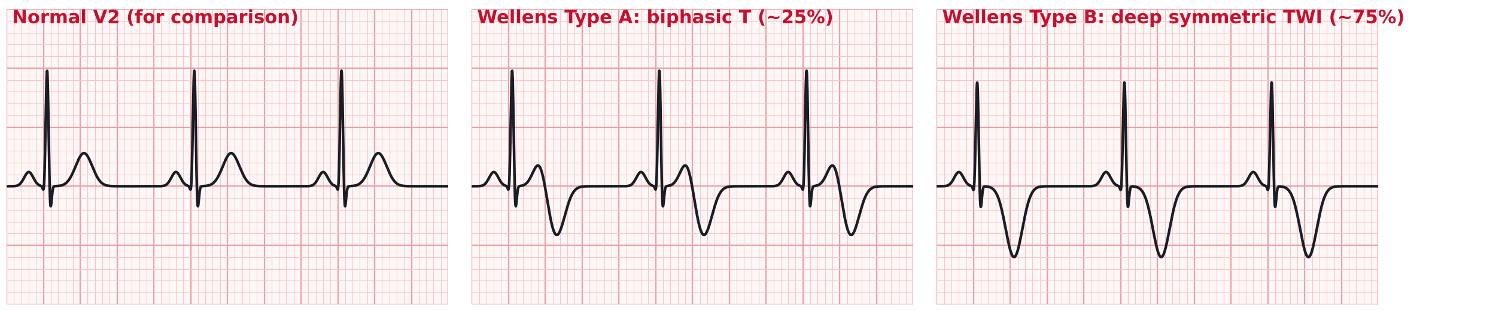
Wellens syndrome
The pattern
How common & the trap
Biphasic (Type A, ~25%) or deeply inverted symmetric (Type B, ~75%) T waves in V2–V3 (± V1–V6)
Minimal/no ST elevation, no Q waves, preserved R waves
Recorded while PAIN-FREE — the ECG during pain may be normal or show STE
Troponin normal or minimally elevated
~14–18% of unstable angina admissions (de Zwaan 1982); a few % of ED chest pain
75% developed anterior MI within weeks without revascularization
Critical LAD stenosis → NO stress test. Exercise = occlusion
Office: pain-free + this ECG = ED now
Notes:
[17:00–18:15] Wellens: the classic office miss, because the patient feels fine. The pattern is recorded in the pain-free interval; the artery has reperfused for now. de Zwaan's original series: 18% of UA admissions, and 75% of the untreated went on to anterior MI within a mean of 8.5 days. Rhinehardt's follow-up series similar.
Two traps: (1) troponin is frequently normal — a negative troponin does not downgrade a Wellens ECG; (2) the reflex "let's get an outpatient stress test" is the wrong reflex — that's a critical proximal LAD lesion and exercise can occlude it. These patients go to the ED today for admission and angiography.
Differential: RV strain from PE (TWI V1–V4 plus inferior), hypertrophic cardiomyopathy, pediatric/juvenile T pattern, raised ICP. Compare with the old ECG — a NEW biphasic or deep TWI in V2–V3 in a patient with recent chest pain is Wellens until cath says otherwise.

Slide 16
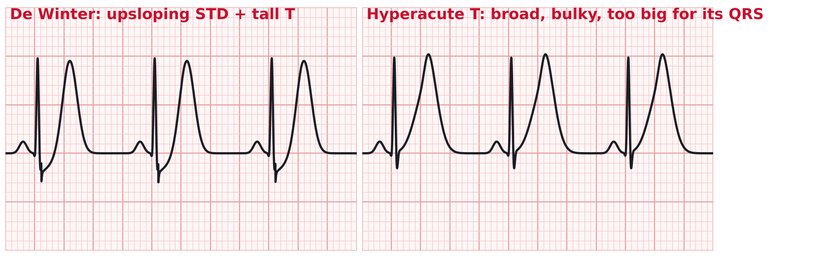
De Winter & hyperacute T waves
De Winter (~2% of anterior occlusions)
Hyperacute T waves (minutes 0–30)
Upsloping ST depression ≥1 mm at J point V1–V6 + tall, symmetric, 'peaked' T waves; ± 1–2 mm STE in aVR
Static pattern (does not evolve to STE) — proximal LAD occlusion
Activate cath lab as a STEMI equivalent (2022 ACC consensus)
Broad-based, bulky, asymmetric, 'too big for its QRS'
Earliest ECG change of occlusion; precedes STE. Common in the first ECG of OMI
Mimics: hyperkalemia (narrow, tented), normal variant, LVH. Repeat ECG q15–30 min
Notes:
[18:15–19:15] Two "first minutes" patterns. De Winter (NEJM 2008 letter): 2% of 1,890 anterior MIs, mean age 50, and — importantly — it is a static pattern; it doesn't march on into ST elevation, so waiting for "evolution" is a mistake. The ACC 2022 expert consensus on chest pain ECGs lists it as a STEMI equivalent for cath-lab activation.
Hyperacute T waves are the earliest finding — the ST segment hasn't lifted yet. Key is proportion: a T wave that dwarfs its QRS in V2–V4. In the office, you will see this in the patient whose pain started 20 minutes ago. Action: 911, aspirin, and send a copy of the ECG with the patient; the ED's repeat ECG will likely show STE.
Both patterns: if you're not sure, treat the patient, not the tracing — ongoing ischemic pain + a "funny-looking" ECG goes by ambulance regardless of the name you give it.

Slide 17
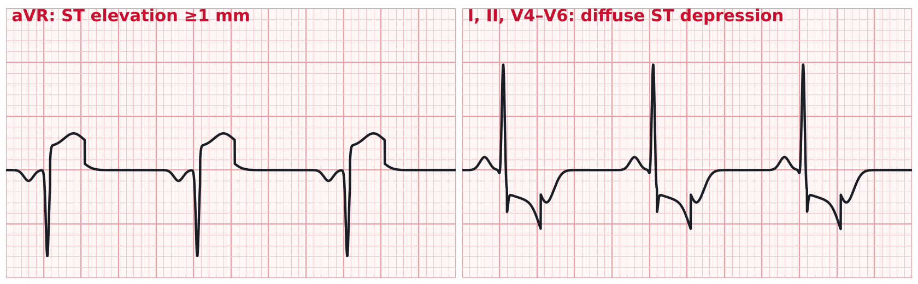
aVR elevation
aVR STE ≥1 mm + diffuse STD (≥6 leads)
Left main / proximal LAD / 3-vessel disease — OR global demand (tachyarrhythmia, anemia, sepsis, post-arrest)
Present in ~5–10% of NSTEMI; rare (<1%) in undifferentiated ED chest pain
Specificity for LM is modest; with ongoing pain it's an emergent cath conversation
Office: any ST depression in a chest-pain patient is an ED-now ECG
Notes:
[19:15–20:30] aVR: the most over-called and under-understood lead. ST elevation in aVR with widespread ST depression means the whole subendocardium is ischemic — that's left main or triple vessel disease when there's ongoing chest pain and a normal rhythm, but it's also what SVT at 180, a hemoglobin of 5, or sepsis looks like. Kosuge and others: present in ~5–10% of NSTE-ACS and it carries roughly a 3–4× mortality. In undifferentiated ED chest pain it's well under 1%. The office takeaway is simpler: ST depression of any kind in a chest-pain patient is an ED-now ECG.
The rogues' gallery on the right — I won't belabor each. The one to actually remember is posterior MI, because it's the most common isolated miss: ST depression in V1–V3 with upright T waves and a tall R in V1 — that's ST elevation seen from the back. Posterior leads V7–V9 confirm. The rest — modified Sgarbossa for LBBB and paced rhythms, the South African flag, Aslanger — are the names you'll hear from the ED when we call you back.
Rule for all of them: new ST depression, new T-wave inversion in a territory, or anything you'd describe as "weird" on a chest-pain ECG is not a 72-hour cardiology referral. It's an ED visit today.

Slide 18
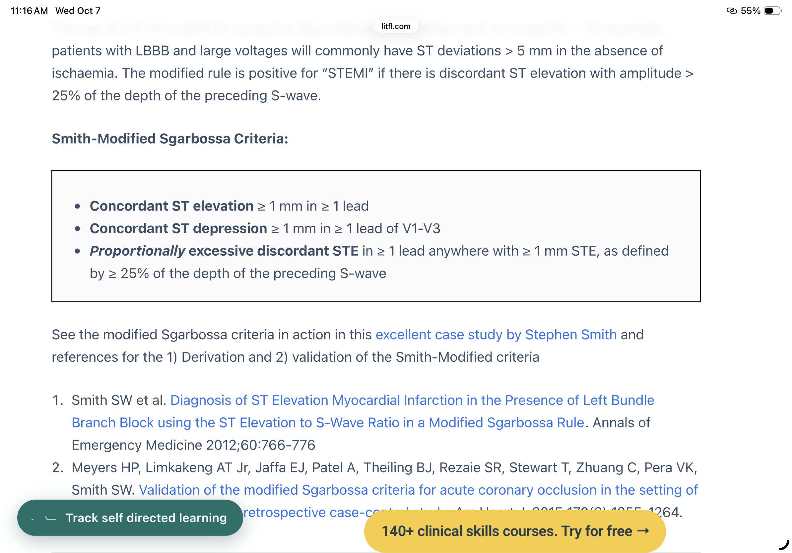
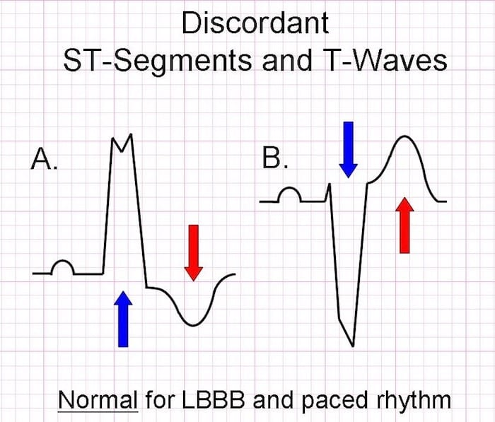
Modified Sgarbossa
https://litfl.com/wp-content/uploads/2018/08/Sgarbossa-criteria-T-wave_discordance-.jpg
Notes:
[19:15–20:30] aVR: the most over-called and under-understood lead. ST elevation in aVR with widespread ST depression means the whole subendocardium is ischemic — that's left main or triple vessel disease when there's ongoing chest pain and a normal rhythm, but it's also what SVT at 180, a hemoglobin of 5, or sepsis looks like. Kosuge and others: present in ~5–10% of NSTE-ACS and it carries roughly a 3–4× mortality. In undifferentiated ED chest pain it's well under 1%. The office takeaway is simpler: ST depression of any kind in a chest-pain patient is an ED-now ECG.
The rogues' gallery on the right — I won't belabor each. The one to actually remember is posterior MI, because it's the most common isolated miss: ST depression in V1–V3 with upright T waves and a tall R in V1 — that's ST elevation seen from the back. Posterior leads V7–V9 confirm. The rest — modified Sgarbossa for LBBB and paced rhythms, the South African flag, Aslanger — are the names you'll hear from the ED when we call you back.
Rule for all of them: new ST depression, new T-wave inversion in a territory, or anything you'd describe as "weird" on a chest-pain ECG is not a 72-hour cardiology referral. It's an ED visit today.

Slide 19
How often will you actually see these?
Why rare matters
These are order-of-magnitude estimates pooled from ED cohorts — your office denominator is ~5× smaller for ACS
The equivalents are each ≤1–2% of ED chest pain — but together they account for a large share of MISSED occlusions
Rare + high-stakes = the exact profile of a cognitive miss
Defense: ECG in 10 min, compare to old, and treat any new ST/T change in a chest-pain patient as a 'go'
Notes:
[20:30–21:00] One chart, one point. STEMI is ~3% of ED chest pain; each of the equivalents is under 2%. These are rough numbers pulled from different cohorts — don't quote decimals — the shape is what matters. Rare plus high-stakes is exactly what gets missed, which is why I spent five minutes on it. Transition to Objective 2: now that we know who's dangerous, who can actually stay?

Slide 20
Who can stay? Who must Go?
Objective 2 & 3: low-risk features, validated tools, and the disposition ladder

Slide 21
Low risk is a definition, not a feeling
Marburg Heart Score (primary care, validated)
'Can stay' requires ALL of these
Age/sex: man ≥55 or woman ≥65 — 1 pt
Known vascular disease (CAD, CVD, PAD) — 1 pt
Pain worse with exercise — 1 pt
Pain NOT reproducible by palpation — 1 pt
Patient assumes pain is cardiac — 1 pt
Score 0–2 → CAD ≈ 2–3%
(sens 87%, spec 81% on external validation)
Score ≥3 → CAD ≈ 20–25% → urgent evaluation
Validated for STABLE outpatient chest pain. Not a tool for ongoing pain, abnormal vitals, or an abnormal ECG.
Normal vital signs
ECG normal AND unchanged
Pain-free now, or pain that is clearly reproducible/positional/pleuritic with an alternative explanation
No Deadly Six red flag from the Objective 1 slide
Marburg ≤2 (if cardiac is on the list) and Wells-low + PERCENT Neg/D-dimer Neg today (if PE is on the list)
Stable pattern - not new, not accelerating, not at rest
Reliable follow-up and a patient who will return
Notes:
[21:00–22:30] Objective 2. The tool I want you to use is the Marburg Heart Score because it was derived and validated in primary care, not the ED — five items, no troponin, no imaging. 0–2 = ~2–3% CAD; ≥3 = ~20%+. External validation (Haasenritter, BJGP 2012) gave sensitivity 87%, specificity 81%; the INTERCHEST pooled analysis (Aerts, J Clin Epidemiol 2017) built a related rule from five cohorts. Its limit: it predicts stable CAD as the cause of the pain; it was never meant to disposition a patient with pain right now, abnormal vitals, or an abnormal ECG. Those are excluded before you ever score.
The right-hand column is the checklist. The item I'd underline is "ECG unchanged from prior" — "normal" is a weaker statement than "unchanged". A biphasic T in V2 can be a normal variant until you see last year's ECG was flat.
Note: stable vs acute is the real fork. The 2021 AHA/ACC chest pain guideline draws exactly that line — new onset or changing pattern is acute chest pain and belongs in the ED; stable, predictable, months-old is the office.

Slide 22
Objective 3: The disposition ladder
5
911 — ambulance, now
Ongoing ischemic pain; any abnormal VS; ECG with new ST/T change or STEMI equivalent; suspected dissection, tamponade, tension PTX, rupture; syncope with chest pain
4
ED today — private car OK
Pain resolved but new/changing pattern (unstable angina); needs troponin, D-dimer, CT or CXR you can't get today; PERC-positive with moderate gestalt; small PTX suspected with normal VS
3
Same day: ECG + lab troponin + cardiology/CP clinic ≤72 h
Stable exertional pattern >48 h pain-free, normal unchanged ECG, Marburg ≥3 — only if your system can return a troponin within hours and act on it
2
Routine outpatient work-up
Marburg ≤2, normal unchanged ECG, no red flags, PE excluded by PERC or D-dimer; stress/CCTA
1
Reassure and treat
Clear alternative diagnosis (costochondritis, zoster, GERD with classic features) AND all 'can stay' criteria met. Document the negatives.
Notes:
[22:30–24:00] Objective 3 — the money slide. Five rungs. The top two are "go"; the bottom three are "stay" in some form.
Three rules that settle most arguments:
1. If you need a test you can't get back today to be comfortable — troponin, D-dimer, CT, a chest film — the patient goes to the ED. You can't disposition on a result you don't have.
2. If you're reaching for aspirin, you're reaching for the phone. Ongoing pain that you believe is ischemic travels by ambulance, not in the passenger seat with a spouse — ~5% of these patients have a dysrhythmia in the first hour, and a car can't defibrillate.
3. "Pain-free now" is not "low risk." It's the setting for Wellens and for unstable angina. Pattern change within the last 2 weeks is acute chest pain per the 2021 guideline and belongs on rung 4, not rung 2.
Rung 3 is deliberately narrow: same-day troponin pathways exist in some systems and not others. If yours can't act on a positive troponin at 6 pm, that patient is rung 4.

Slide 23
Before the ambulance: the 10-minute office bundle
1
Call 911 first
2
12-lead ECG
Don't finish the workup, then call. Call, then continue.
Send a copy with the patient and fax/photo to the receiving ED. Repeat if pain changes.
3
Aspirin 324 mg chewed
4
Two-arm BP, SpO₂, pulsus
If ACS suspected
The vital signs you haven't taken are the ones the ED will ask about.
5
Oxygen only if SpO₂ < 90%
6
Nitro SL if SBP > 100
Hyperoxia harms in ACS (AVOID, DETO2X).
No PDE5 inhibitor in 24–48 h; caution with inferior/RV pattern. Relief means nothing diagnostically.
7
IV access if you can; AED in the room
8
Hand-off
First-hour VF is the thing the ambulance ride prevents.
One-line story: onset, VS, ECG read, meds given, your leading concern.
Notes:
[24:00–24:45] Quick practical slide. Two things people get wrong: calling 911 last instead of first, and giving oxygen to a patient saturating 97%. The aspirin-hold for dissection is the only nuance that matters. Send the ECG — a photo on a phone is fine — because the comparison is the thing we need most.

Slide 24
Stay or Go?
Three Cases to Review

Slide 25
Case 1: the 'indigestion' that climbs stairs
58-year-old woman, type 2 diabetes, hypertension, never-smoker. Comes in for a 'medication refill' and mentions two days of intermittent upper-abdominal 'indigestion' and unusual fatigue.
It's happened 4–5 times, each 10–15 minutes, twice while carrying laundry upstairs, resolved with rest. Last episode ~6 hours ago. Pain-free now. Tums 'helped a little.'
VS: BP 138/84 both arms, HR 76, SpO₂ 98%, afebrile. Exam: mildly tender at the left costochondral junctions that 'sort of' reproduces it. Lungs clear, no murmur.
ECG: NSR, biphasic T waves in V2–V3, no ST elevation, no Q waves. Her ECG from 2 years ago: normal.
Marburg score: exertional (+1), assumes cardiac? 'No, I think it's my stomach' (0), reproducible (0), age/sex <65 (0), no vascular disease (0) = 1.
Vote in the chat:
STAY
GO
Notes:
[25:00–26:00] Read it, let them vote. The case is engineered so every soft signal says "stay": Marburg 1, pain-free, reproducible tenderness, antacid response. Give them 30 seconds.

Slide 26
Case 1: the verdict
GO
ED today- This is Wellens syndrome.
What pulled you the wrong way
What should have decided it
Marburg = 1 — but Marburg is only valid with a normal, unchanged ECG. The ECG disqualifies the score before you add it up
Reproducible tenderness: LR 0.2–0.4, not zero.
'Tums helped': LR ≈ 1. GI cocktail response is not a test
Pain-free for 6 hours: this is the Wellens window — the LAD has reperfused for now
'Indigestion' + fatigue in a diabetic woman is the textbook anginal equivalent
NEW biphasic T waves in V2–V3 vs a normal prior ECG, in a patient with a 2-day history of exertional symptoms = Wellens Type A until cath says otherwise
Disposition: ED today; EKG->911. Aspirin 324 mg before she leaves; ECG goes with her
Notes:
[26:00–27:00] Verdict: GO. The lesson is hierarchy — the ECG sits above the score. Marburg, HEART, PERC: every one of them assumes you've already looked at the ECG and it's not the problem. Here the ECG IS the problem.
Ask the room: who would have ordered a stress test? Be gentle — it's the natural reflex, and it's the specific thing that kills the Wellens patient. Also surface the anginal-equivalent point: "indigestion" in a diabetic woman over 50 earns an ECG every time, even on a refill visit.
Disposition nuance for the purists: pain-free, normal vitals — car is OK with instructions; many of us would still call the ambulance given the LAD lesion. Either is defensible; outpatient referral is not.

Slide 27
Case 2: the sharp pain that's 'mostly better'
34-year-old man, 6'3", 160 lb, smokes half a pack/day. Three days ago, while lifting a couch, sudden sharp left-sided chest pain 'like a knife', worst at the moment it started, with some shortness of breath.
It's 'mostly better' now — a dull ache, worse with deep breaths, and he's 'a little winded' on the stairs, which he attributes to being out of shape. No cough, no hemoptysis, no leg symptoms, no travel, no surgery.
VS: BP 124/78, HR 92, RR 16, SpO₂ 97% RA, afebrile. Exam: breath sounds equal bilaterally, no chest-wall tenderness, no crepitus, calves soft and symmetric.
ECG: normal sinus rhythm, no abnormality. Office has no X-ray; nearest imaging is the urgent care 15 minutes away or the ED 25 minutes away.
PERC: age <50 ✓, HR <100 ✓, SpO₂ ≥95 ✓, no hemoptysis ✓, no estrogen ✓, no surgery/trauma ✓, no prior VTE ✓, no leg swelling ✓ → PERC negative.
Vote in the chat:
STAY
GO
Notes:
[27:00–27:45] Vote. The bait: PERC-negative, normal everything, getting better, and mechanical onset (lifting). Many will say stay/MSK.

Slide 28
Case 2: the verdict
GO (by car)
He needs a chest XR Today- a normal exam cannot exclude a pneumothorax. PERC is the wrong tool for this question.
What pulled you the wrong way
What should have decided it
PERC answers one question — is PE excluded — and it's only valid when your gestalt is <15%. It says nothing about pneumothorax
'Breath sounds equal' has ~50–75% sensitivity for PTX; a 15–20% pneumothorax routinely sounds normal
'Improving over 3 days' is the natural history of a small spontaneous PTX, not evidence against it
Mechanical onset (lifting) is a classic PSP trigger
HR 92 and 'winded on stairs' in a 34-year-old are soft but real
Abrupt, maximal-at-onset, pleuritic + dyspnea in a tall thin young smoker: the risk for PSP is high enough that you must image today
Normal vitals → not 911; same-day CXR (upright PA ± expiratory) or POCUS, at urgent care if it's reliable, otherwise ED
If small (<2 cm) and minimally symptomatic, conservative management is reasonable
Document that PE was considered and PERC-negative
Notes:
[27:45–28:30] Verdict: GO, but by car — rung 4 on the ladder. The point is "right tool, right question." PERC was applied correctly and does exclude PE; it was never asked about pneumothorax. The exam is the trap: equal breath sounds is a normal finding in a meaningful fraction of pneumothoraces.
Second point: a disposition can be "needs imaging today" without being "needs an ambulance." If your office had a probe or an X-ray, this patient could potentially have stayed. Disposition follows the test you need.
If someone argues MSK: ask what they'd document if the patient comes back with a 40% PTX next week after flying to see his parents.

Slide 29
Case 3: the hypertensive man who feels better
71-year-old man, poorly controlled hypertension (stopped amlodipine 2 months ago, 'made my ankles swell'), ex-smoker. Walked into the office 70 minutes after sudden severe anterior chest pain that started while he was moving a trash can — 'like someone hit me', 10/10 instantly.
Now 3/10, 'mostly between my shoulder blades'. One episode of nausea. No syncope. He'd like to go home; his wife made him come.
VS: BP 184/102 right arm; the MA repeats on the left: 156/90. HR 68, SpO₂ 97%. Exam: comfortable sitting forward, lungs clear, soft early diastolic murmur at the left sternal border that nobody has documented before. Pulses palpable ×4, maybe slightly weaker left radial. Neuro normal.
ECG: sinus at 66, LVH with repolarization changes — 1 mm ST depression V5–V6 that looks like strain. No prior ECG available.
Your partner says: 'Hypertensive urgency with strain pattern — give him his amlodipine back, aspirin for the possible ACS, and see him Friday.'
Vote in the chat:
STAY
GO
Notes:
[28:30–29:15] Vote. Bait: pain resolving, bradycardia-ish, no prior ECG so the strain pattern is "probably old", and a confident colleague offering a tidy story. The thing the ACS story does — aspirin — is the thing that hurts him.

Slide 30
Case 3 : the verdict
911 — NOW
Acute aortic dissection until proven otherwise. Call the ambulance, control HR and BP in the ED, CTA chest.
What pulled you the wrong way
What should have decided it
'Much better now' — dissection pain classically waxes and wanes
The strain pattern and no prior ECG invite anchoring on 'hypertensive urgency'
Three findings from the Objective 1 slide, all present: abrupt maximal-at-onset pain , 28 mmHg arm-to-arm difference, and a NEW diastolic murmur
Migration chest → interscapular
ADD-RS = 2 (high-risk pain + high-risk exam) → CTA regardless of D-dimer
911, no antithrombotics, IV in, ECG and both BPs sent with him, call the ED directly
Notes:
911. Hit the three findings: abrupt onset, arm-to-arm BP difference, new diastolic murmur. Any one of them should stop the aspirin; all three are a dissection until a CT says otherwise. ADD-RS 2 means no D-dimer, straight to CTA.
Close the loop with the partner's plan: nothing in it is crazy on the surface. The error isn't knowledge — everyone in the room knows dissection — it's that the vital signs were taken and not weighed. The two-arm BP was done by the MA, which is the whole point of training the front of the office to flag it.
Wrap: three cases, three "pain-free / improving" patients, three gos. That's deliberate — "feels better now" is the most dangerous phrase in chest pain.

Slide 31
Lightning round: the one who can stay
46-year-old woman, 3 weeks of pain
Verdict: STAY- with one condition
Brief (seconds), sharp, left parasternal stabs, several times a day, never with exertion; worse twisting in bed
Reproduced exactly by pressing the 2nd–3rd costochondral junctions
No risk factors; takes a combined oral contraceptive; no leg symptoms
VS normal; ECG normal and unchanged from last year
Marburg: 0 (she assumes it's 'anxiety', not cardiac). Wells = 0 — but PERC fails (estrogen)
Every 'can stay' box is checked: normal VS, unchanged ECG, reproducible, non-exertional, Marburg 0, 3-week stable pattern
PERC can't be applied (estrogen)- so PE is excluded by Wells ≤4 + a negative D-dimer. Order it
Costochondritis is a diagnosis you may make once PE is off the table
reassure, NSAIDs, return precautions
STAY

Slide 32
Three things to take back to the office
Findings that end the visit
1
High LR SX/ PE findings for ACS; arm-to-arm BP >20; any abnormal vital; a new harsh murmur; a quiet hemithorax; distended neck veins
The ECG outranks every score
2
New ST depression, new T-wave inversion in a territory, Wellens, De Winter, aVR- none of these get a Marburg or a stress test. They get an trip to the ED.
If you need a test you can't get today, they go
3
Troponin, D-dimer, CT, chest film- disposition follows the test. And if you reach for aspirin, reach for the phone.

Slide 33
References
Tintinalli JE, Ma OJ, Yealy DM, et al., eds. Tintinalli's Emergency Medicine: A Comprehensive Study Guide, 9th ed. McGraw-Hill, 2020 — Ch 48 Chest Pain; Ch 49 Acute Coronary Syndromes; Ch 55 Cardiomyopathies and Pericardial Disease; Ch 56 Venous Thromboembolism Including Pulmonary Embolism; Ch 59 Aortic Dissection and Related Aortic Syndromes; Ch 68 Pneumothorax; Ch 77 Esophageal Emergencies.
Swap CJ, Nagurney JT. Value and limitations of chest pain history in the evaluation of patients with suspected acute coronary syndromes. JAMA 2005;294(20):2623–9.
Klompas M. Does this patient have an acute thoracic aortic dissection? JAMA 2002;287(17):2262–72.
Nazerian P, Mueller C, Soeiro AM, et al. Diagnostic accuracy of the aortic dissection detection risk score plus D-dimer for acute aortic syndromes: the ADvISED prospective multicenter study. Circulation 2018;137(3):250–8.
Chunilal SD, Eikelboom JW, Attia J, et al. Does this patient have pulmonary embolism? JAMA 2003;290(21):2849–58.
Kline JA, Mitchell AM, Kabrhel C, et al. Clinical criteria to prevent unnecessary diagnostic testing in ED patients with suspected pulmonary embolism. J Thromb Haemost 2004;2(8):1247–55.
Freund Y, Cachanado M, Aubry A, et al. Effect of the PERC rule on subsequent thromboembolic events among low-risk ED patients: the PROPER randomized clinical trial. JAMA 2018;319(6):559–66.
Roy CL, Minor MA, Brookhart MA, Choudhry NK. Does this patient with a pericardial effusion have cardiac tamponade? JAMA 2007;297(16):1810–8.
Alrajab S, Youssef AM, Akkus N, Caldito G. Pleural ultrasonography versus chest radiography for the diagnosis of pneumothorax: review of the literature and meta-analysis. Crit Care 2013;17(5):R208.
Roberts ME, Rahman NM, Maskell NA, et al. British Thoracic Society Guideline for pleural disease. Thorax 2023;78(Suppl 3):s1–s42.
Brinster CJ, Singhal S, Lee L, et al. Evolving options in the management of esophageal perforation. Ann Thorac Surg 2004;77(4):1475–83.
de Zwaan C, Bär FW, Wellens HJ. Characteristic electrocardiographic pattern indicating a critical stenosis high in left anterior descending coronary artery in patients admitted because of impending myocardial infarction. Am Heart J 1982;103(4):730–6.
de Winter RJ, Verouden NJ, Wellens HJ, Wilde AA. A new ECG sign of proximal LAD occlusion. N Engl J Med 2008;359(19):2071–3.
Kosuge M, Kimura K, Ishikawa T, et al. Predictors of left main or three-vessel disease in patients who have acute coronary syndromes with non-ST-segment elevation. Am J Cardiol 2005;95(11):1366–9.
Meyers HP, Bracey A, Lee D, et al. Comparison of the ST-elevation myocardial infarction (STEMI) vs. NSTEMI and occlusion MI (OMI) vs. NOMI paradigms of acute MI. J Emerg Med 2021;60(3):273–84.
Bösner S, Haasenritter J, Becker A, et al. Ruling out coronary artery disease in primary care: development and validation of a simple prediction rule. CMAJ 2010;182(12):1295–300.
Haasenritter J, Bösner S, Vaucher P, et al. Ruling out coronary heart disease in primary care: external validation of a clinical prediction rule. Br J Gen Pract 2012;62(599):e415–21.
Aerts M, Minalu G, Bösner S, et al. (INTERCHEST). Pooled individual patient data from five countries were used to derive a clinical prediction rule for coronary artery disease in primary care. J Clin Epidemiol 2017;81:120–8.
Verdon F, Herzig L, Burnand B, et al. Chest pain in daily practice: occurrence, causes and management. Swiss Med Wkly 2008;138(23–24):340–7.
Gulati M, Levy PD, Mukherjee D, et al. 2021 AHA/ACC/ASE/CHEST/SAEM/SCCT/SCMR Guideline for the Evaluation and Diagnosis of Chest Pain. Circulation 2021;144(22):e368–e454.
Kontos MC, de Lemos JA, Deitelzweig SB, et al. 2022 ACC Expert Consensus Decision Pathway on the Evaluation and Disposition of Acute Chest Pain in the Emergency Department. J Am Coll Cardiol 2022;80(20):1925–60.
McConaghy JR, Sharma M, Patel H. Acute chest pain in adults: outpatient evaluation. Am Fam Physician 2020;102(12):721–7.
Pope JH, Aufderheide TP, Ruthazer R, et al. Missed diagnoses of acute cardiac ischemia in the emergency department. N Engl J Med 2000;342(16):1163–70.
Body R, Carley S, Wibberley C, et al. The value of symptoms and signs in the emergent diagnosis of acute coronary syndromes. Resuscitation 2010;81(3):281–6.

