Slide 1
Setting Expectations and Giving Feedback
August 11, 2023
Presented by:
Gina DeFranco,DO, Associate Professor and Chair of Family Medicine

Slide 2
Join at slido.com #3440041
ⓘ Start presenting to display the joining instructions on this slide.

Slide 3
Disclosures
There are no commercial interests associated with this presentation.
I have no conflicts of interest regarding the information contained in this presentation.

Slide 4
Objectives
Apply One-Minute-Learner/preceptor concept for setting the stage
Create a safe and productive atmosphere for students to use feedback as a growth experience
Use outcomes of immediate feedback to compile long-term feedback
Use available instruments to help in providing feedback
Apply the Prepare to ADAPT process for both in-time and comprehensive feedback

Slide 5
Use one or two words to describe your favorite teacher.
ⓘ Start presenting to display the poll results on this slide.

Slide 6
Use one or two words to describe your favorite coach.
ⓘ Start presenting to display the poll results on this slide.

Slide 7
Teaching vs coaching
Teaching
Providing information
Providing support
Nurturing
Coaching
Learner accountability
Reflective learning
Goal-oriented collaboration
Notes:
Teaching = Providing information, providing support, nurturing
Coaching = Learner accountability; working with learner towards a goal

Slide 8
Preceptor as Coach
Asks questions
Discuss the hard truths
Encourage change
Promote accountability
Follow progress
Notes:
Coaching is a two-way street!! The coach succeeds when the learner progresses – everyone wins
All coaches are not right for all players/learners…

Slide 9
Perspectives
Feedback is very important to trainees
Encourages self-reflection and improvement for the students
Changes the mindset about change!

Slide 10
Giving Feedback is Coaching!
Common concerns surrounding giving feedback
Making feedback valuable and meaningful
Being in a space/place where feedback is a conversation
Varying practice settings
The expectation of only positive feedback
The “power” differential
First step: Set expectations!
For the student AND yourself

Slide 11
Setting the stage for feedback
Productive feedback starts with setting clear expectations
Overarching expectations for the whole rotation that align with student’s goals
Smaller expectations on a daily/weekly basis
Having a tool to help set expectations eases the process
Take notes – both you and the student
BE SPECIFIC.
Remember coaching is a two-way street!

Slide 12
The One Minute Learner
Perspective: “Students as a guest in my home”
For both student AND preceptor
Meant to be used at the beginning of each teaching/learning session
6 components
Goals – preceptor’s AND student’s
Getting Going – Who and how
How Much and How Long
Presenting
Charting
Questions
Notes:
Link to the article in Family Medicine: www.stfm.org.lmunet.idm.oclc.org/FamilyMedicine/Vol48Issue3/Hoffman222

Slide 13
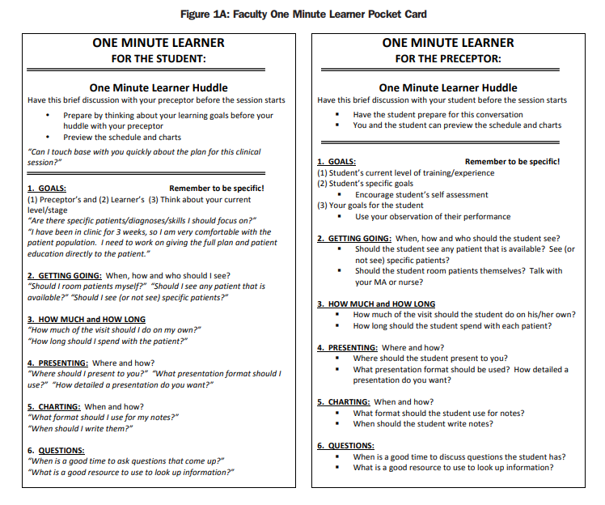
Notes:
https://www.stfm.org/FamilyMedicine/Vol48Issue3/Hoffman222

Slide 14
The One Minute Learner
Goals
Getting Going
What is the student’s level of training?
Ask and observe
Student specific goals
Your goals for the student
Where to be when?
How does patient flow work?
Who to see?
Who is the go-to person for students?

Slide 15
What does "Getting Going" look like in your practice? (When, how, and who should the student see?)
ⓘ Start presenting to display the poll results on this slide.

Slide 16
The One Minute Learner
How Much and How Long
Presenting
What limits do you put on students?
What should they never do unsupervised
Are there time/complexity parameters?
When and where?
What format? How detailed?
What kind of feedback/discussion should they expect?

Slide 17
When, where, and how do you prefer students to present patients?
ⓘ Start presenting to display the poll results on this slide.

Slide 18
The One Minute Learner
Charting
Questions
Where and when?
Access to EHR?
How will student documentation be used?
For you – How do you handle questions?
When is the best time?
Can students use their phone/iPad/Surface/etc?

Slide 19
What are your charting expectations for students?
ⓘ Start presenting to display the poll results on this slide.

Slide 20
Using the One Minute Learner
Define the parameters for each of your practice settings
BE AS SPECIFIC AS POSSIBLE!!
Solidify a time for discussion
Once? Daily? Weekly? If different practice setting?
Utilize staff/nursing to assist

Slide 21
Understanding your learner
Performance-based, fixed mindset
Learning-based, growth mindset
Look good
Conceal deficiencies
Avoid challenge
Avoid working hard
Uncomfortable with feedback
Learn
Seek challenges
Work hard, accept that setbacks happen
Ask for feedback frequently
Notes:
https://depts.washington.edu/lgateway/elearning/feedback/story.html, accessed 4/6/21
Putting judgement on success and failure
Everyone gets a trophy

Slide 22
As a student, what made you most uncomfortable about receiving feedback?
ⓘ Start presenting to display the poll results on this slide.

Slide 23
Shifting the mindset
Emphasize the importance of the process
Praise hard work with successes, not just the successes
Make feedback a normal thing
Walk the talk
Acknowledge your own struggles
Explain your intentions

Slide 24
Opportunities for Feedback
Whenever it is requested by the learner
After a time of planned observation
Patient visit in the clinic, etc
Following a procedure
After a staff interaction
Feedback is a discussion/debrief – a coaching session

Slide 25
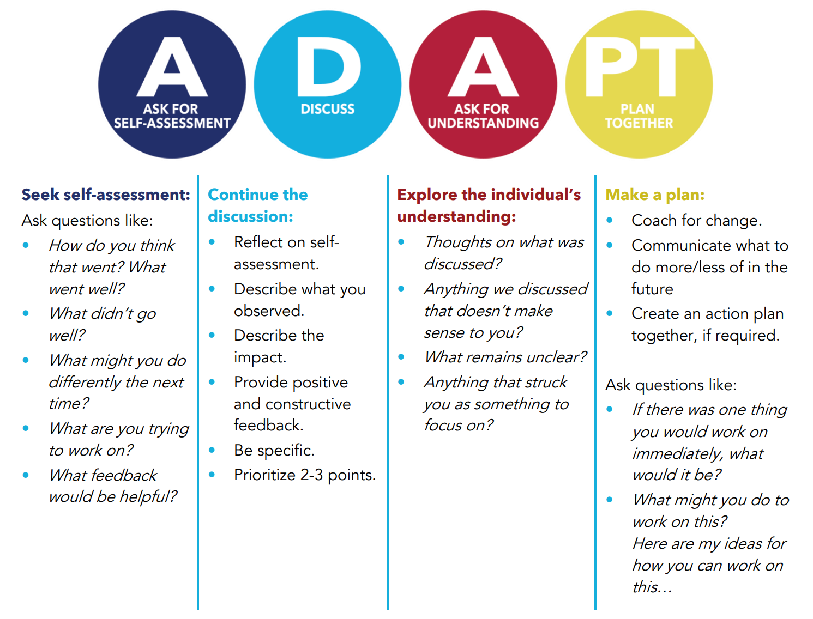
Process for providing feedback
Notes:
https://www.med.upenn.edu/flpd/assets/user-content/documents/Giving%20Real%20Time%20Feedback.pdf; https://sites.uw.edu/uwgme/adapt/

Slide 26
Ask for Self-Assessment
Description of what the LEARNER feels about the situation
Can be used for planned feedback or sought-after feedback
Examples:
How do you feel that went? (for a procedure)
What are you trying to accomplish? (when asked for feedback about a specific task)
What do you need feedback on? (perhaps an advanced learner/colleague)

Slide 27
Discuss
Reflect on the learner’s self-assessment
Discuss what you saw/experienced
Describe the impact – positive or negative
Use the facts – observations vs perceptions
Provide constructive suggestions

Slide 28
Ask for Understanding
Explore their understanding of what was discussed
Ask if clarification is necessary
What do they want to do with this information?
What do they think they need to focus on?

Slide 29
Plan Together
How would you like to move on from here?
What would you like to do to improve upon X?
Let’s make a plan to get you where you want to be
Give actionable advice
Note that this is LAST not FIRST
Lastly…follow progress!

Slide 30
Giving real-time feedback

Slide 31
Putting the process into action
Prepare to give feedback
Use the One Minute Learner to see what the student would like to work on
Ask the student how they best receive feedback
Opportunities for real-time feedback
Procedures
Observed patient visits
Case presentations
When issues arise

Slide 32
Time to PRACTICE!!
Steve Jones, OMSIII has been in the clinic for one week. He wants to improve on his differential diagnosis skills. You see a fairly straightforward patient and ask for his assessment. He points out one plausible diagnosis and a few rare zebras.

Slide 33
Put these statements in order for the ADAPT process with Steve Jones, OMSIII
ⓘ Start presenting to display the poll results on this slide.

Slide 35
Long-term Feedback
Use moments of real-time feedback to prepare for long-term feedback
Use the expectations set for the encounter/day/rotation as a reference
Set aside time to discuss
Use a brief “ADAPT” with each point for a mid-rotation eval
Sit with the student to fill out the form
Ask what their next rotation is, this will help giving feedback
Be specific!

Slide 36
Mid-rotation evaluation
Notes:
Just an example of points to cover – the end-of rotation eval wouldn’t fit on the page
Plan to evaluate the student on each of these components at some point during the rotation.

Slide 37
Overcoming Challenges to Feedback
Work on real-time feedback first
Short and sweet
To the point
Have it in the moment
Get to know your learner as best you can
Setting clear expectations
For the patient, the day, the week, etc
If it’s not going well, set a specific time to reconvene
The key to feedback is learner participation
We’re not telling them what they need to do, we’re helping them work through it

Slide 38
Audience Q&A Session
ⓘ Start presenting to display the audience questions on this slide.

Slide 39
References
Hoffman, M., & Cohen-Osher, M. (2016). The One Minute Learner: Evaluation of a New Tool to Promote Discussion of Medical Student Goals and Expectations in Clinical Learning Environments. Family medicine, 48(3), 222–225. https://pubmed.ncbi.nlm.nih.gov/26950912/
https://sites.uw.edu/uwgme/adapt/
https://www.med.upenn.edu/flpd/assets/user-content/documents/Giving%20Real%20Time%20Feedback.pdf
https://depts.washington.edu/lgateway/files/feedback-can-be-less-stressful.pdf

Slide 40
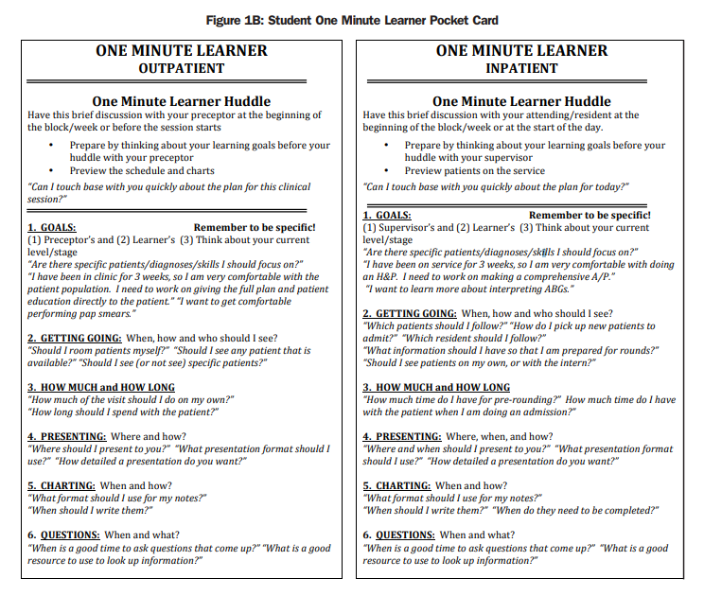
Notes:
BE Specific!

